Slide 1
The geochemist’s periodic table: element partitioning and chemical differentiation
EART26201 | Principles of Geochemistry | Lecture 1
Part 1 | Introduction

Slide 2
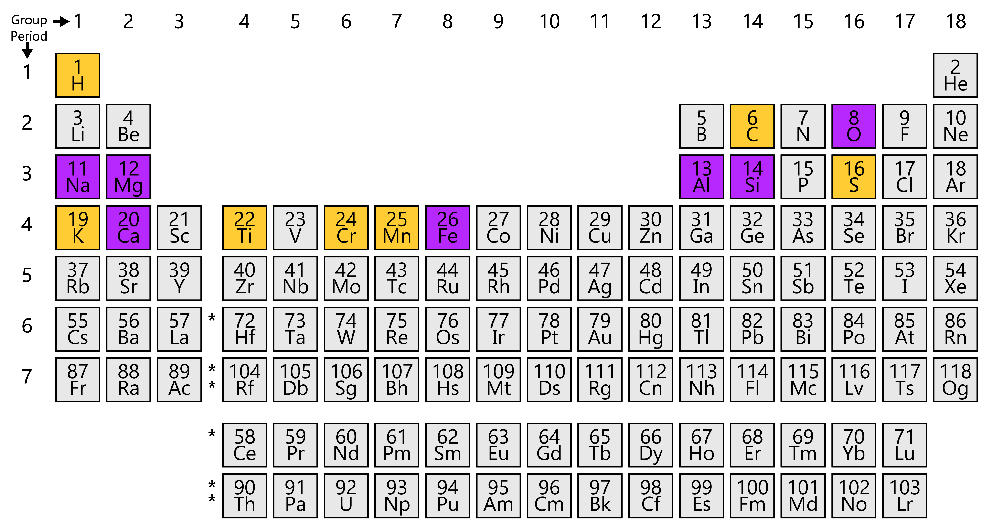
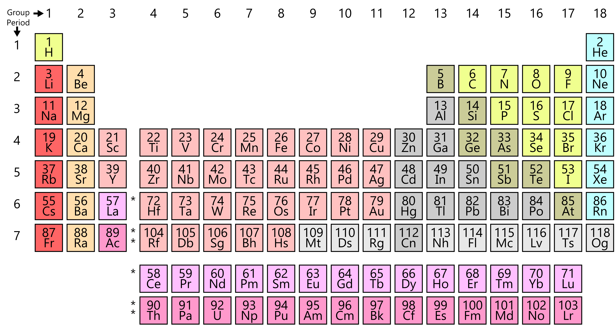
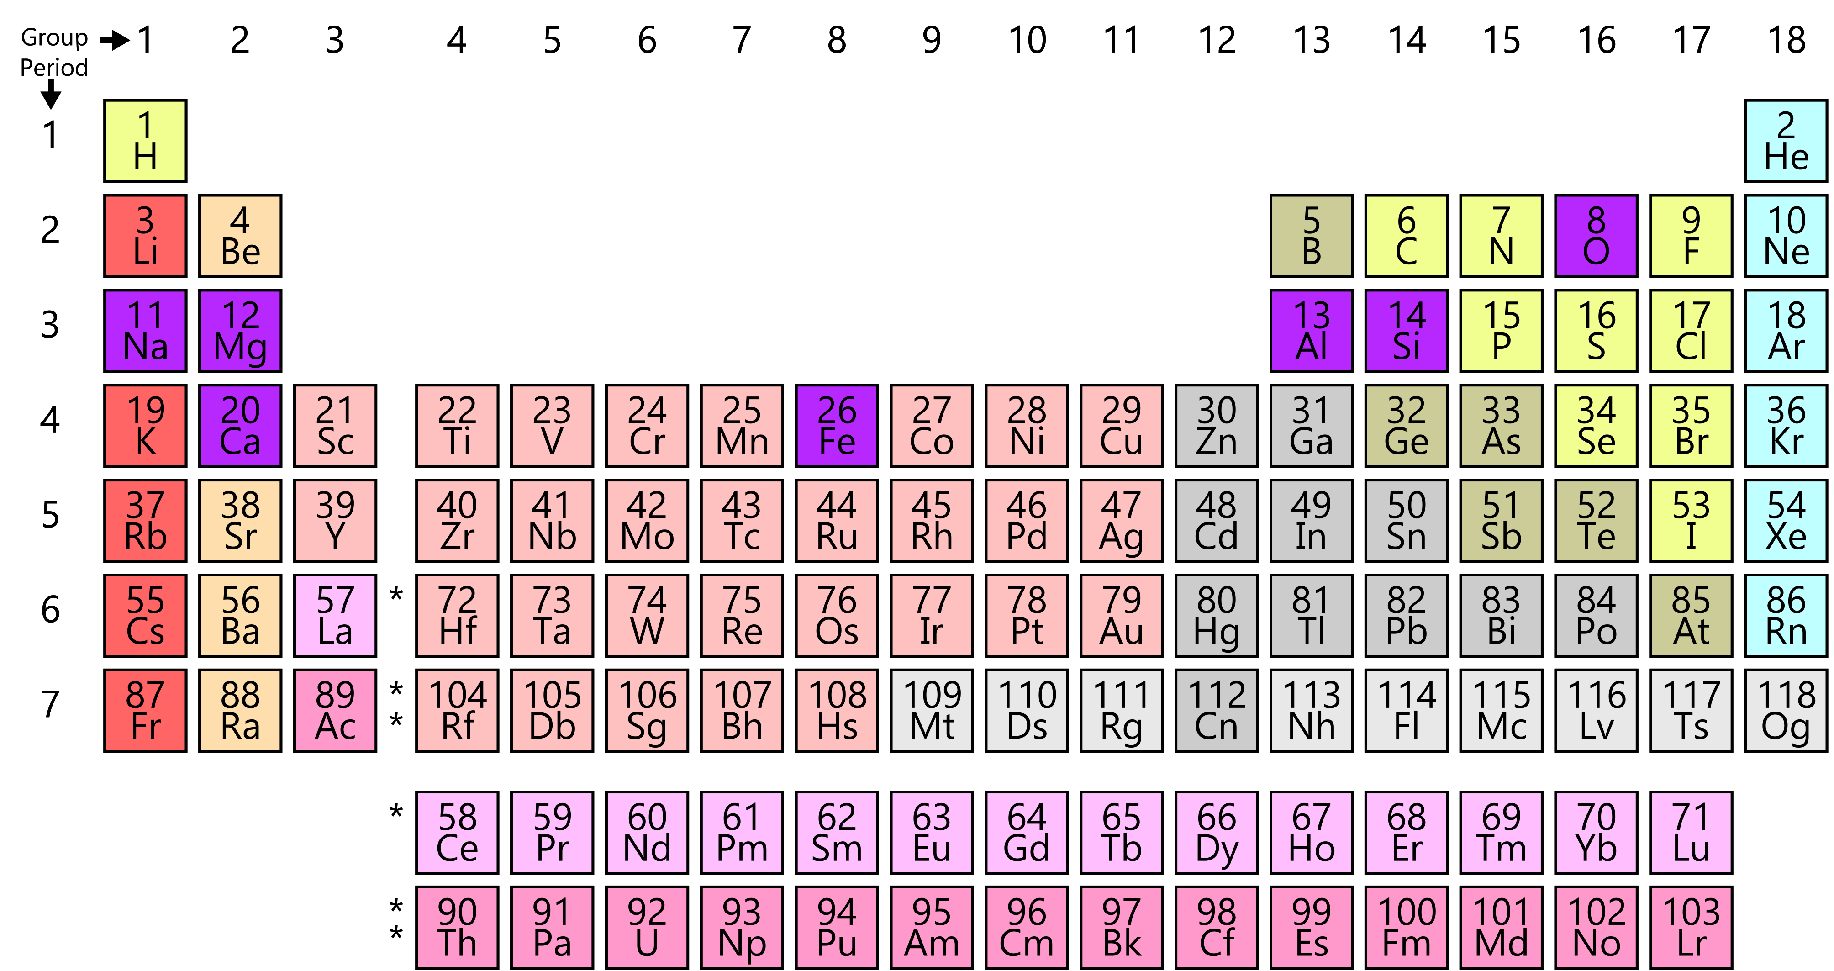
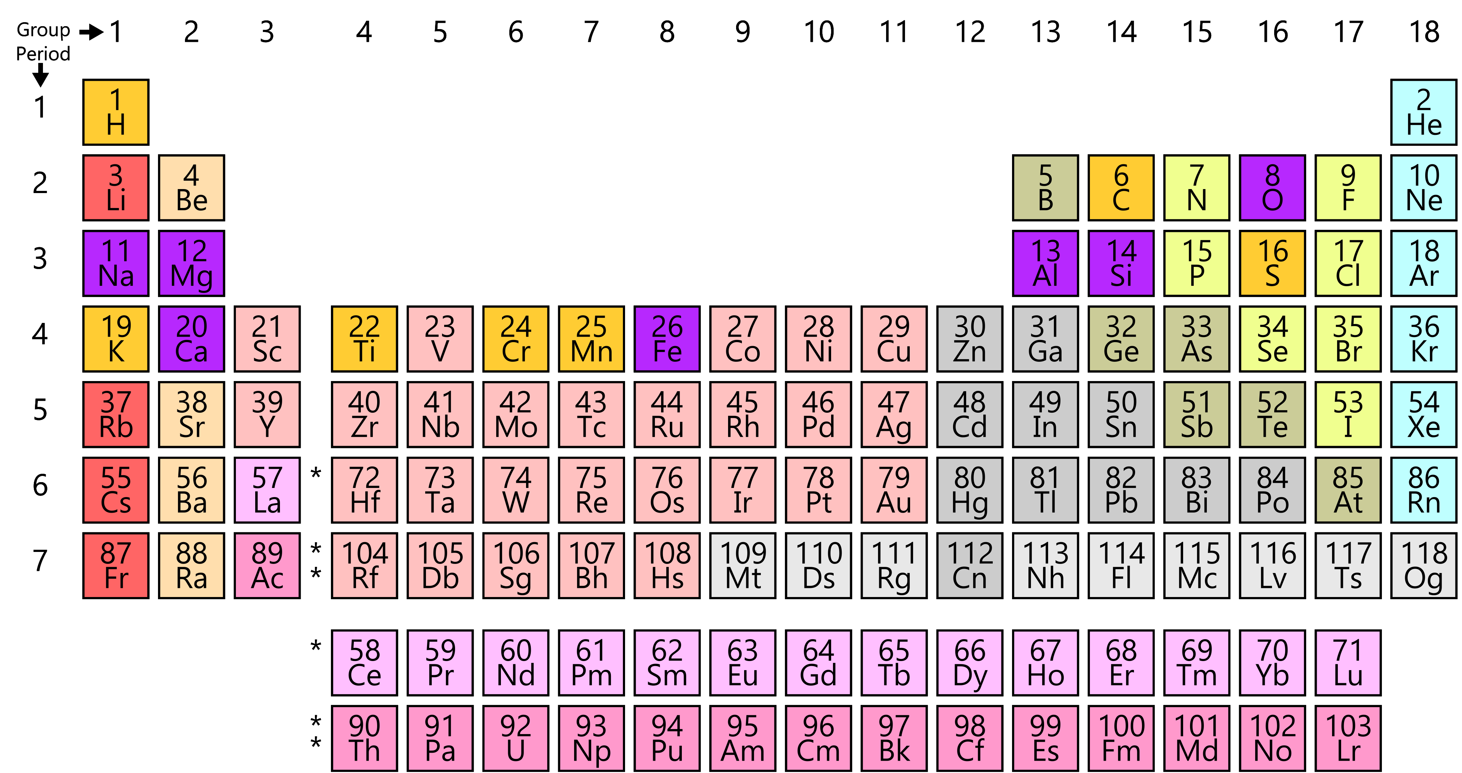
The geochemist’s periodic table
Element abundances vary hugely within and between different planetary bodies
Grouped by abundance
Major elements: >1 wt.%
  O is Earth’s most abundant element and dominant anion
  Other elements are often expressed as oxides (MgO)
  Make rock-forming minerals
Minor elements: 0.1–1 wt.%
Trace elements: <0.1 wt.%

Slide 3
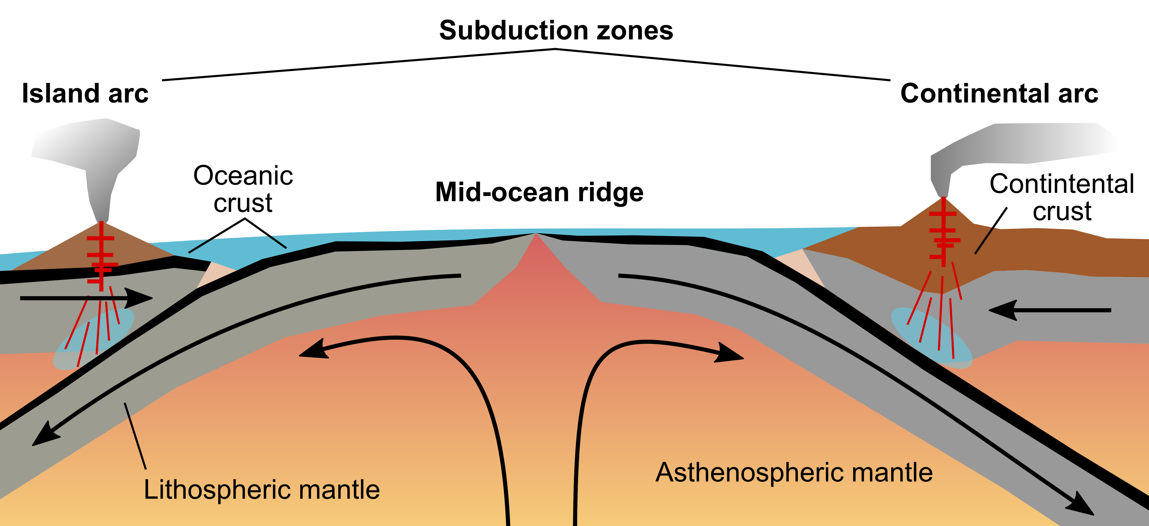

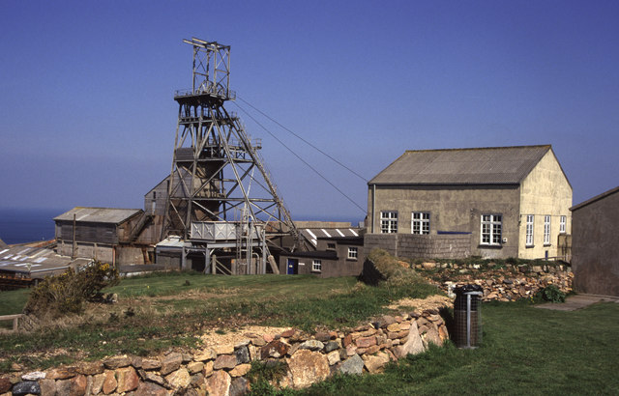

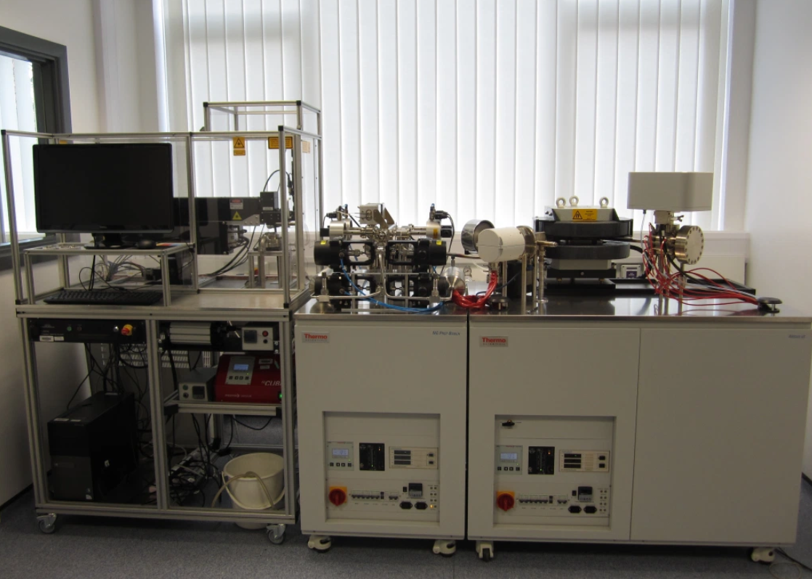
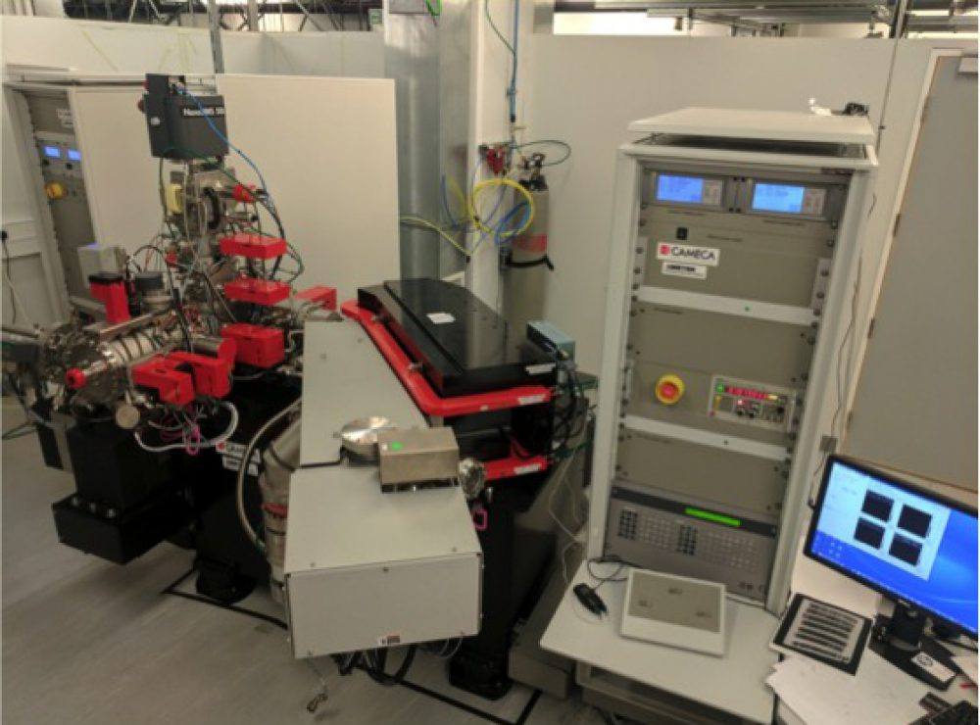


Trace elements as tracers and resources
Not involved in chemical reactions
Passive tracers of Earth processes
Relatively easy to measure by mass spectrometry
Ore deposits occur where trace elements are highly concentrated

Slide 4
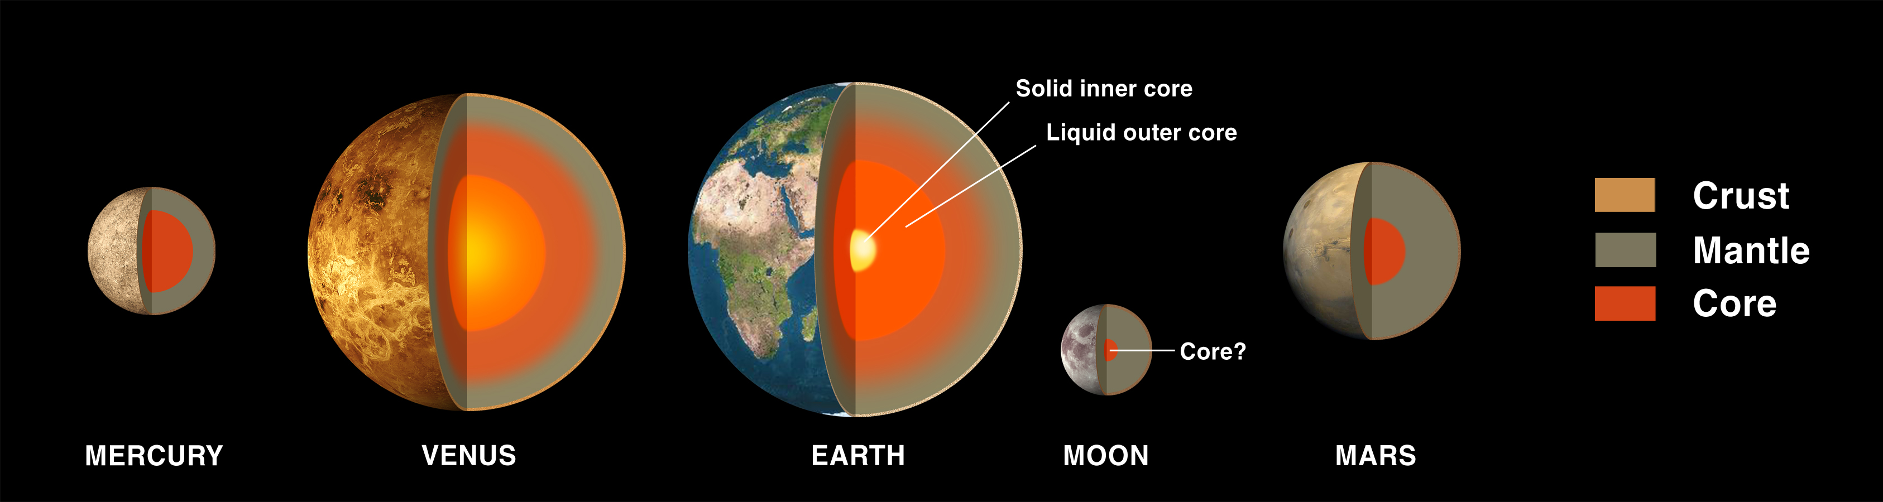
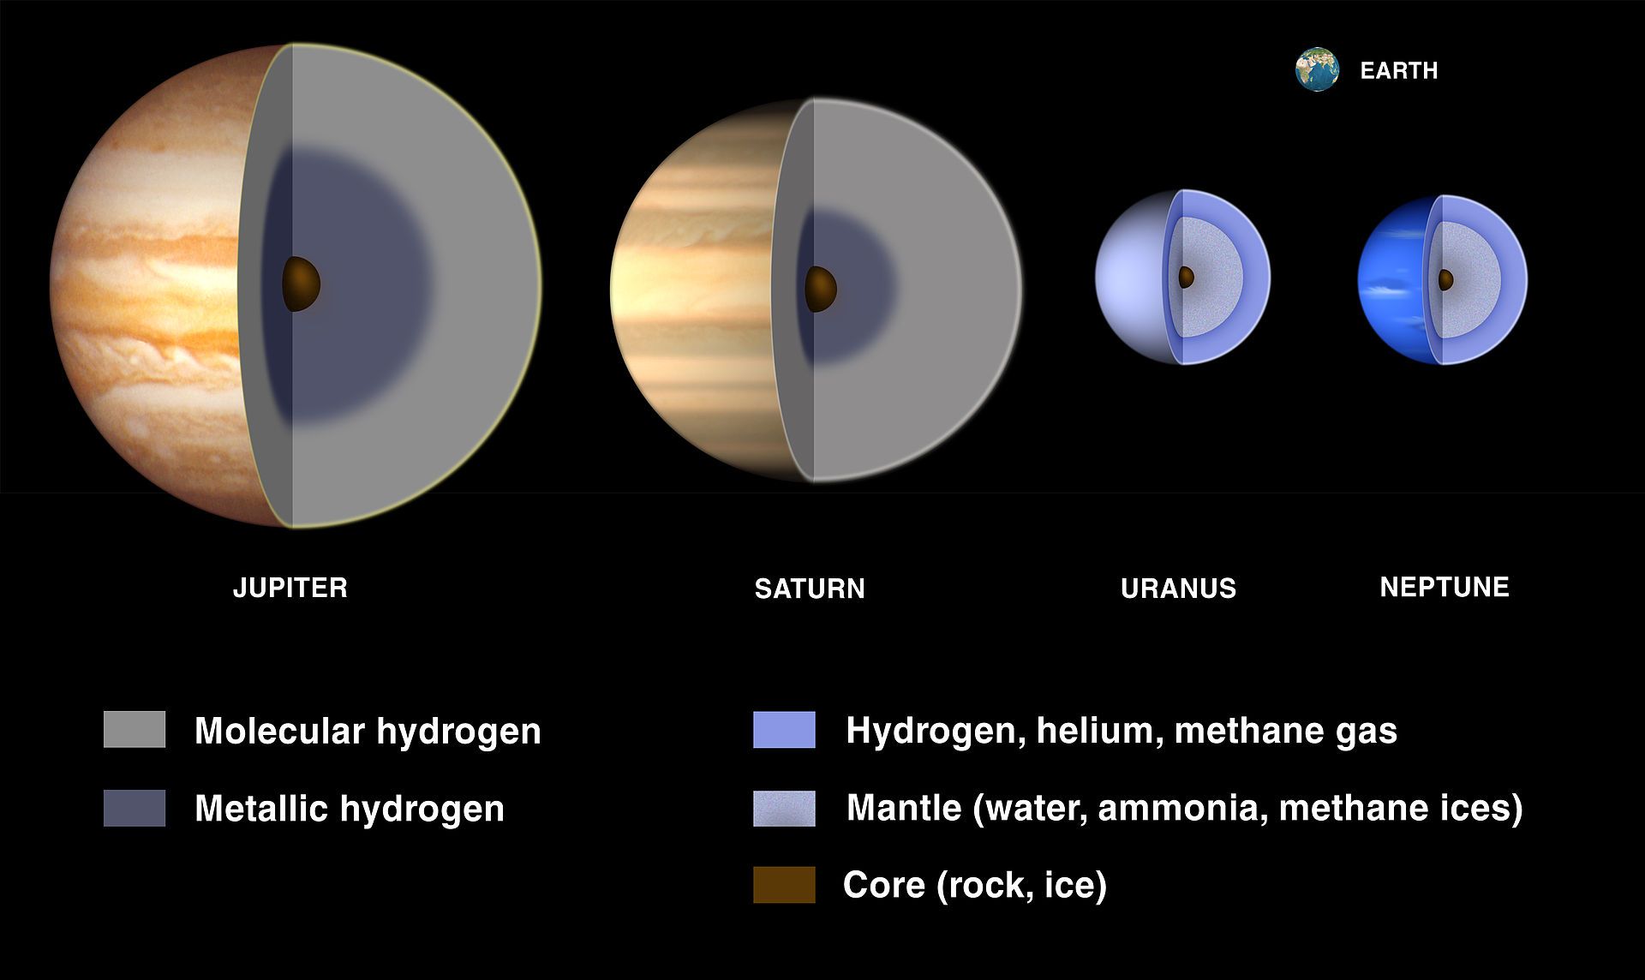
Chemical differentiation
Separation of larger bodies into
chemically distinct parts
The solar system is differentiated:
  Terrestrial planets (Mg, Fe, Si, O)
  Jovian planets (H & He in gas giants; H, He, C & N in ice giants and comets)
Earth is differentiated:
  Core (inner & outer)
  Mantle (asthenospheric & lithospheric)
  Crust (oceanic & continental)
  Atmosphere
Trace elements track differentiation
credit: NASA

Slide 5
Lecture 1 synopsis
Synchronous
Part 1 | Introduction
Part 2 | Cosmochemical and geochemical classifications
Part 3 | Partition coefficients and Goldschmidt’s rules
Part 4 | Using trace elements to model magmatic processes
Part 5 | Chemical differentiation of the Earth
Further reading | Misra, Chapter 12 (Earth formation and trace elements)
Further reading | White, Chapter 11 (Chemical differentiation)

Slide 6
The geochemist’s periodic table: element partitioning and chemical differentiation
EART26201 | Principles of Geochemistry | Lecture 1
Part 2 | Cosmochemical and geochemical classifications

Slide 7
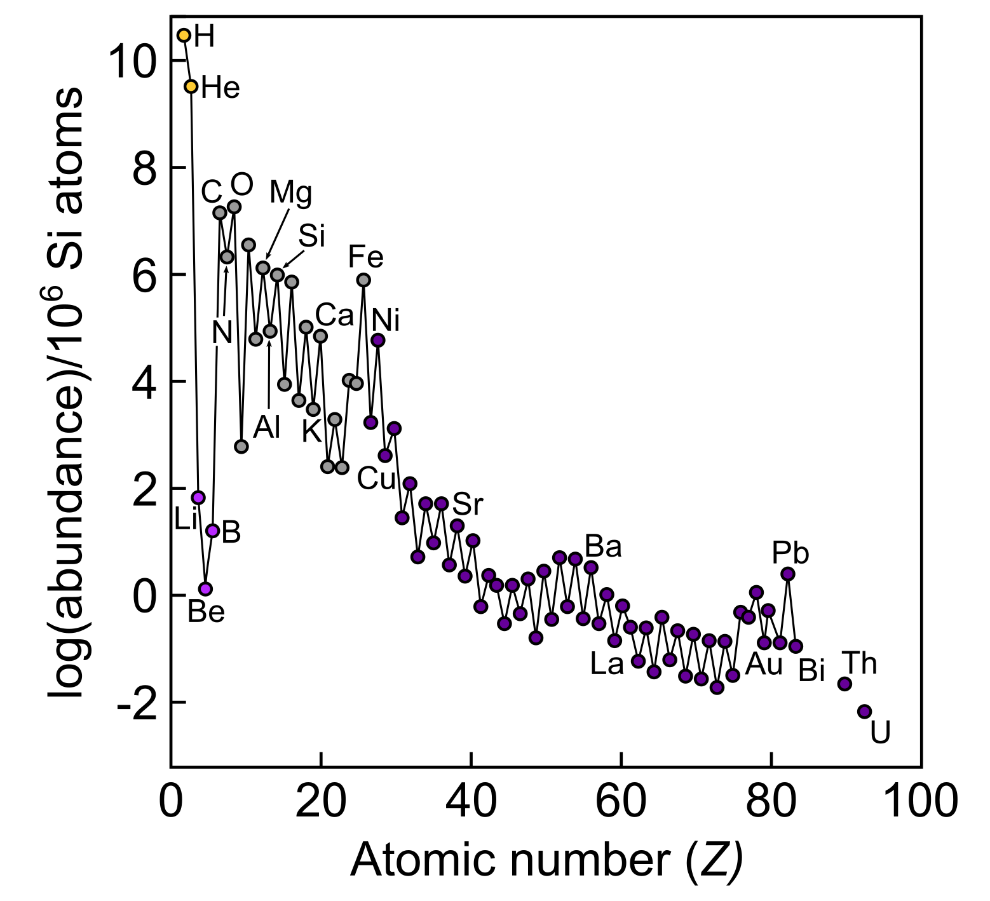
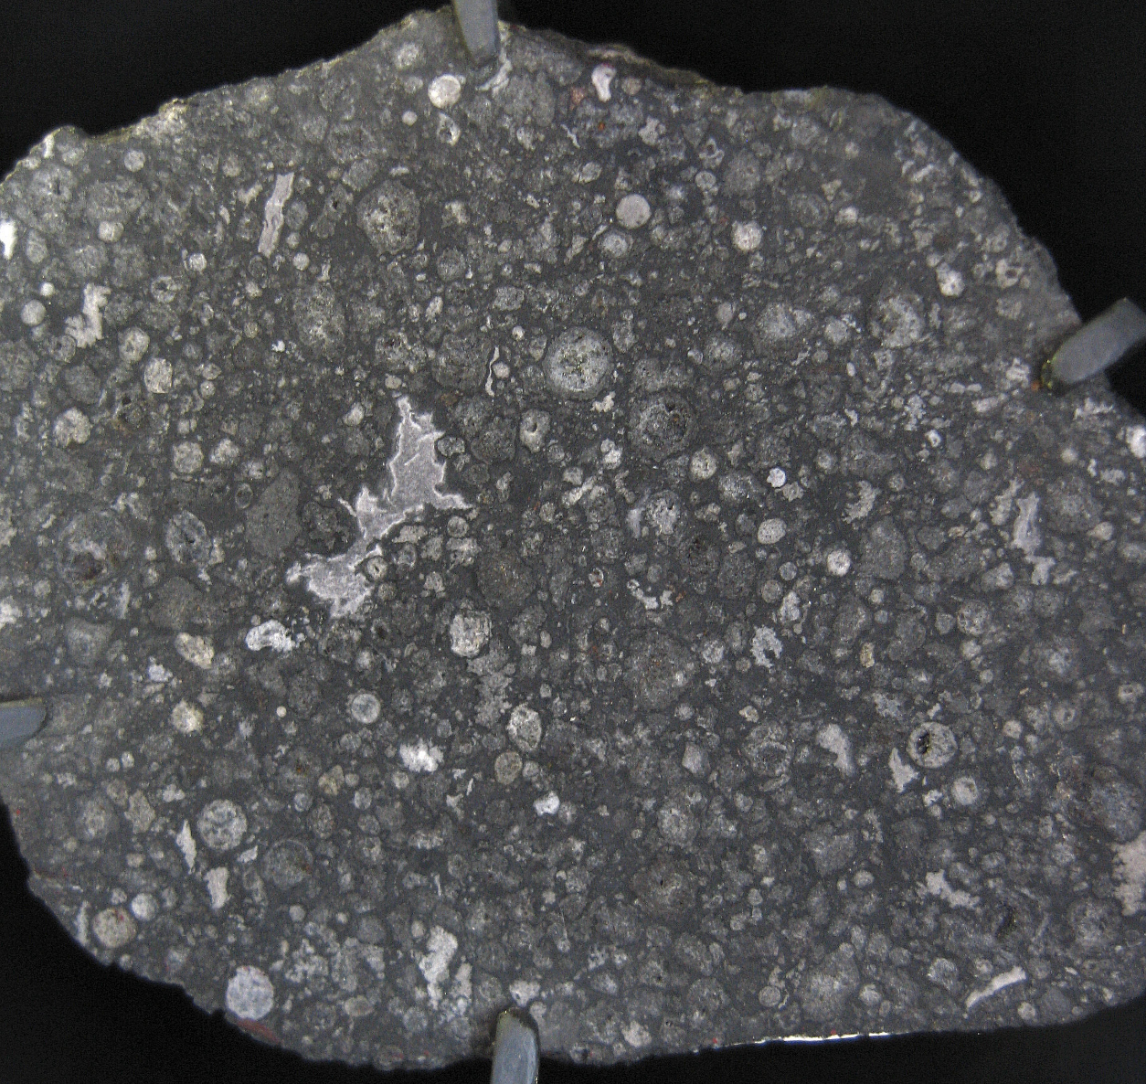
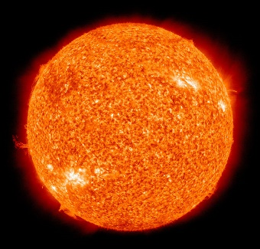

Solar element abundances
Estimates from solar spectroscopy and analyses of CI chondrites
Nucleosynthesis mechanisms:
  H and He from Big Bang
  Li, B and Be from cosmic ray spallation
  C to Fe from stellar fusion
  Ni to Bi from neutron capture (supernovae and neutron star collision)
Major versus trace element divide
Odd-even effect (Oddo-Harkins rule):
  Paired protons are more stable
  Affects how we present data
Allende CI chondrite
(credit: AMNH meteorites)

Slide 8
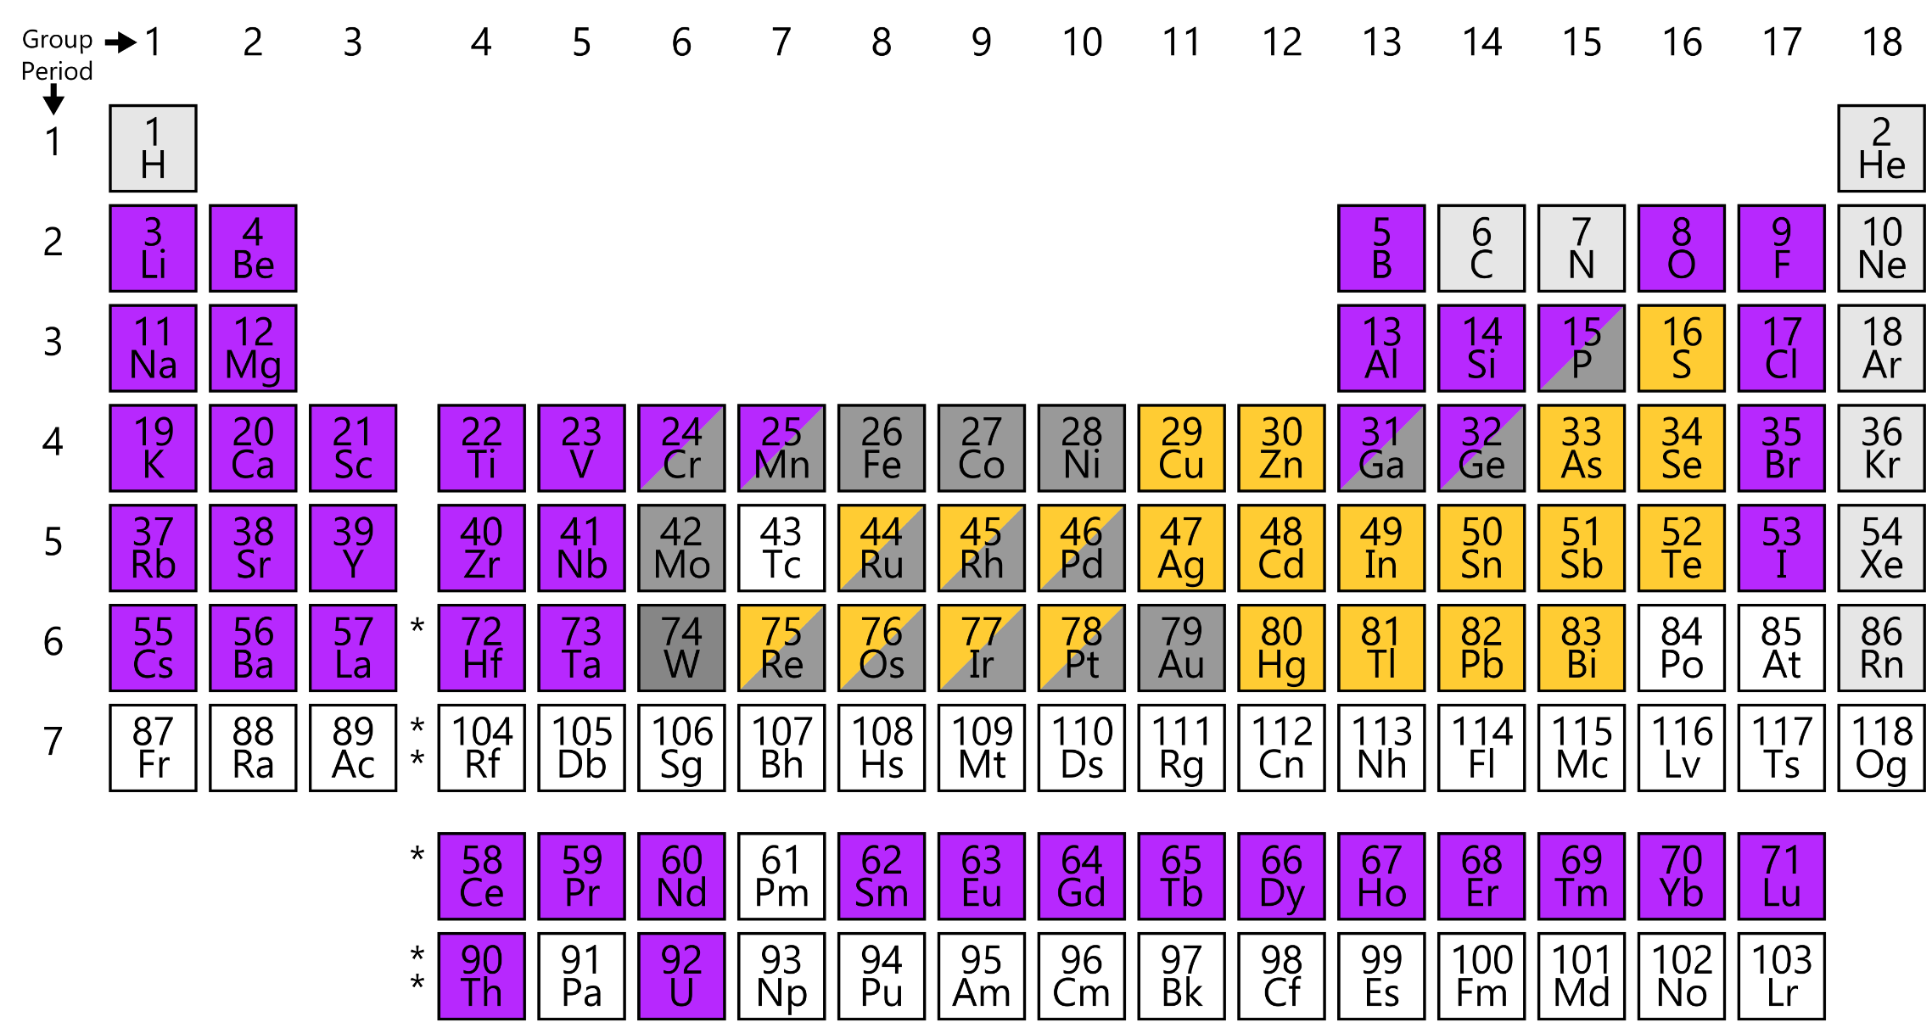
Geochemical classification: partitioning behaviour
Classified by partitioning affinities in liquid systems:
  Siderophile (iron liquid)
  Chalcophile (sulfide liquid)
  Lithophile (silicate liquid)
  Atmophile (gas)
Greek philos means ‘loving’
Partitioning affinity can vary depending on conditions
Controls element distributions between geochemical reservoirs

Slide 9
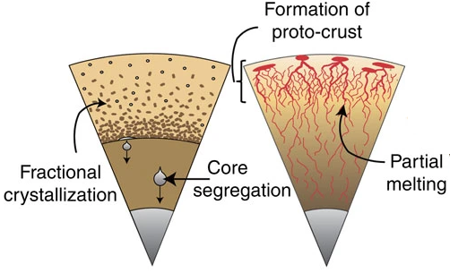
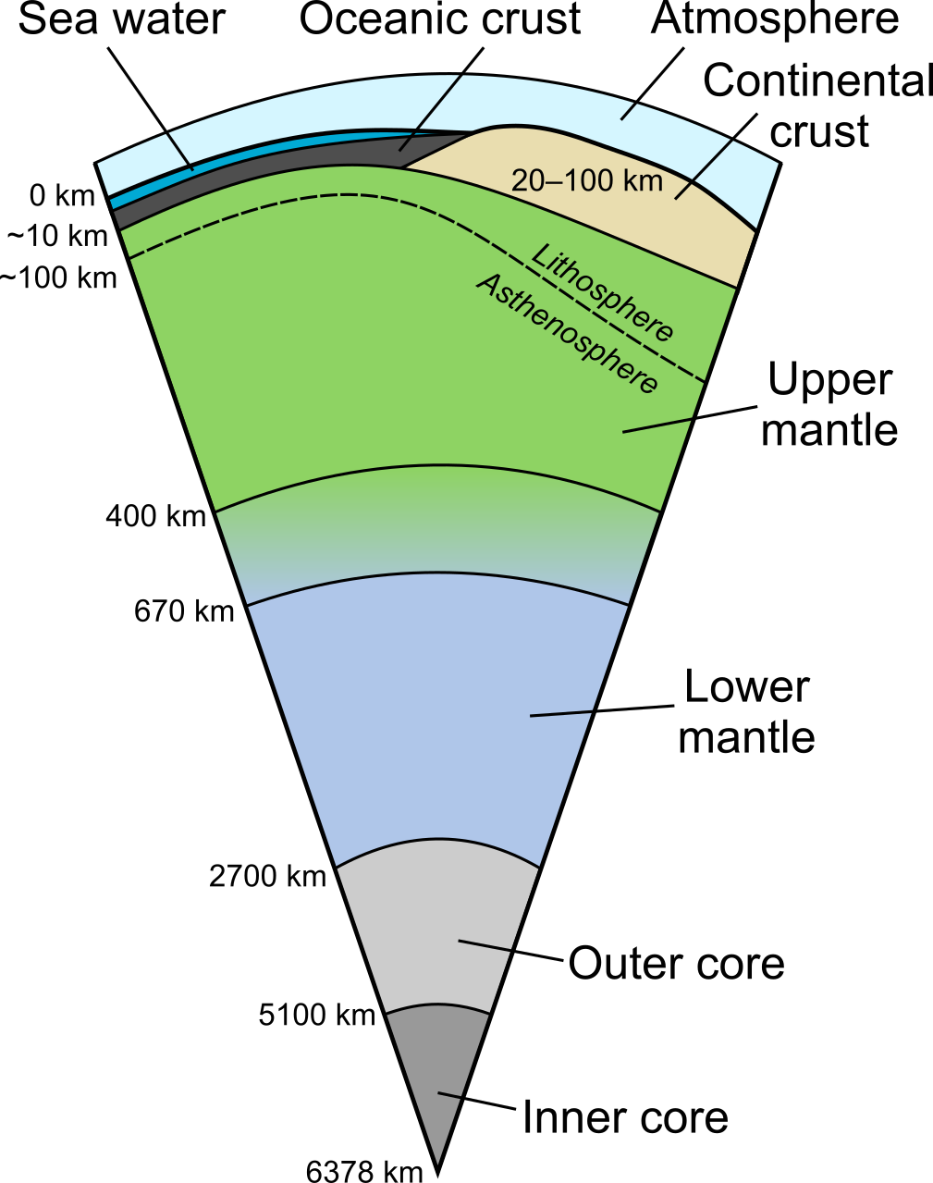
Geochemical classification: chemical differentiation
Hadean Earth (~4.4 Ga)
Modern Earth
Ores
Siderophile (iron liquid)
Chalcophile (sulfide liquid)
Lithophile (silicate liquid)
Atmophile (gas)

Slide 10
The geochemist’s periodic table: element partitioning and
chemical differentiation
EART26201 | Principles of Geochemistry | Lecture 1
Part 3 | Partition coefficients and Goldschmidt’s rules

Slide 11
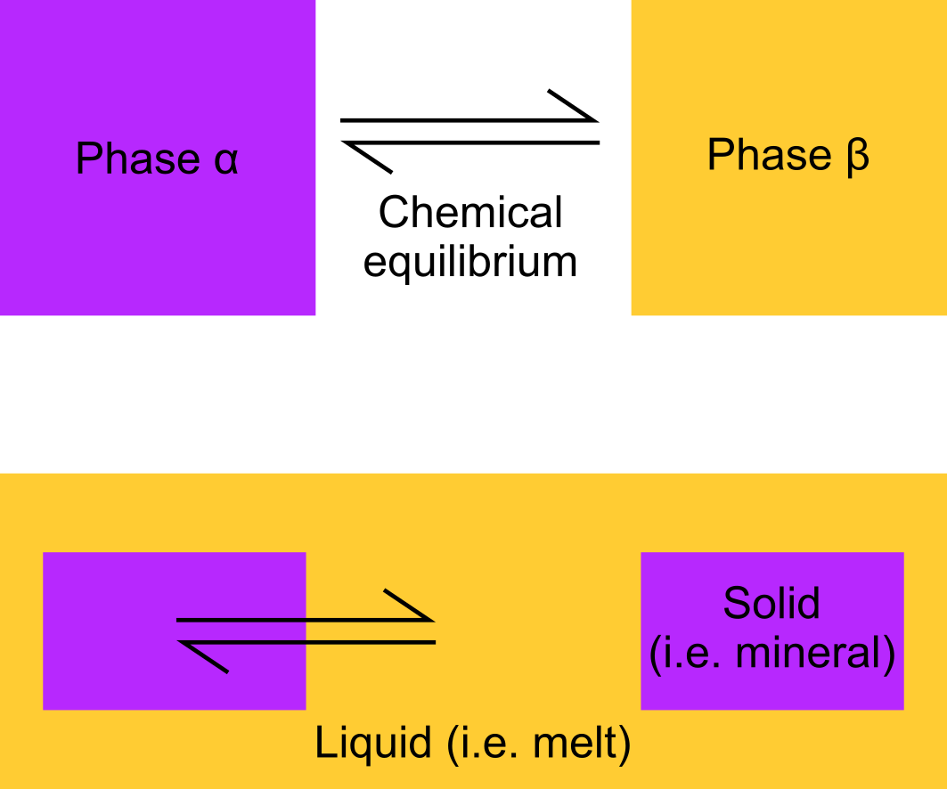
Partition coefficients
Equilibrium concentration ratio $D$ (or $K$) of the of element $i$ in phases $∝$ and $β$:
$$D_{i}^{∝−β}=\frac{C_{i}^{α}}{C_{i}^{β}}$$
  Usually expressed in terms of weight
  Different from diffusion coefficient (also $D$!)
In magmas, $D_{i}$is expressed as follows:
$$D_{i}=\frac{C_{i}^{solid}}{C_{i}^{liquid}}$$
  When $D_{i}<1$, element $i$ is incompatible
  When $D_{i}>1$, element $i$ is compatible

Slide 12
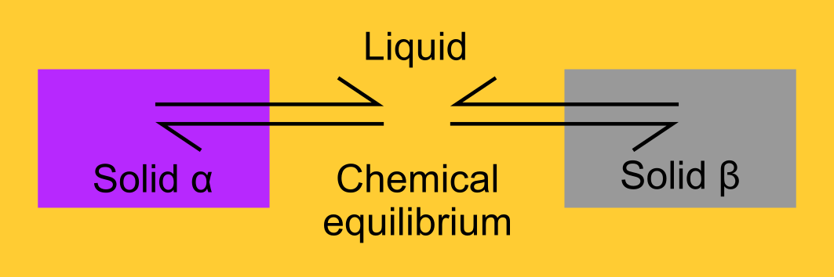
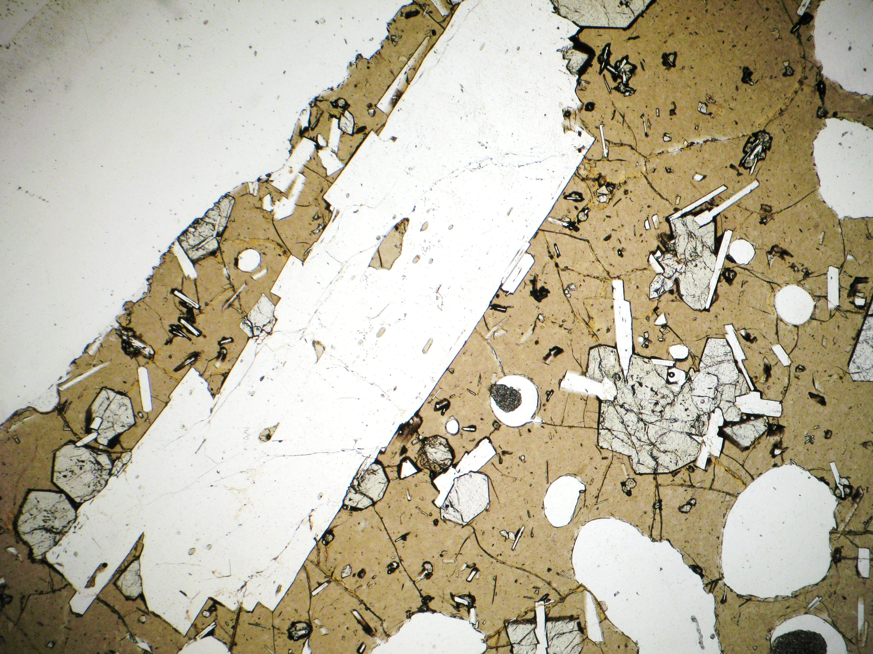
Bulk partition coefficients
Magmas often contain multiple solids
The bulk partition coefficient (${\overline{D}}_{i}$) is the sum of relative contributions of solids $j→n$:
$${\overline{D}}_{i}=\sum_{j=1}^{n}{W^{j}D_{i}^{j}}$$
  where $W^{j}$, is the weight % of solid $j$, and $D_{i}^{j}$ is the partition coefficient of element $i$ in solid $j$.
In a natural basaltic magma:
  Liquid – basaltic melt (quenched to glass)
  Solids – olivine, feldspar and pyroxene

Slide 13
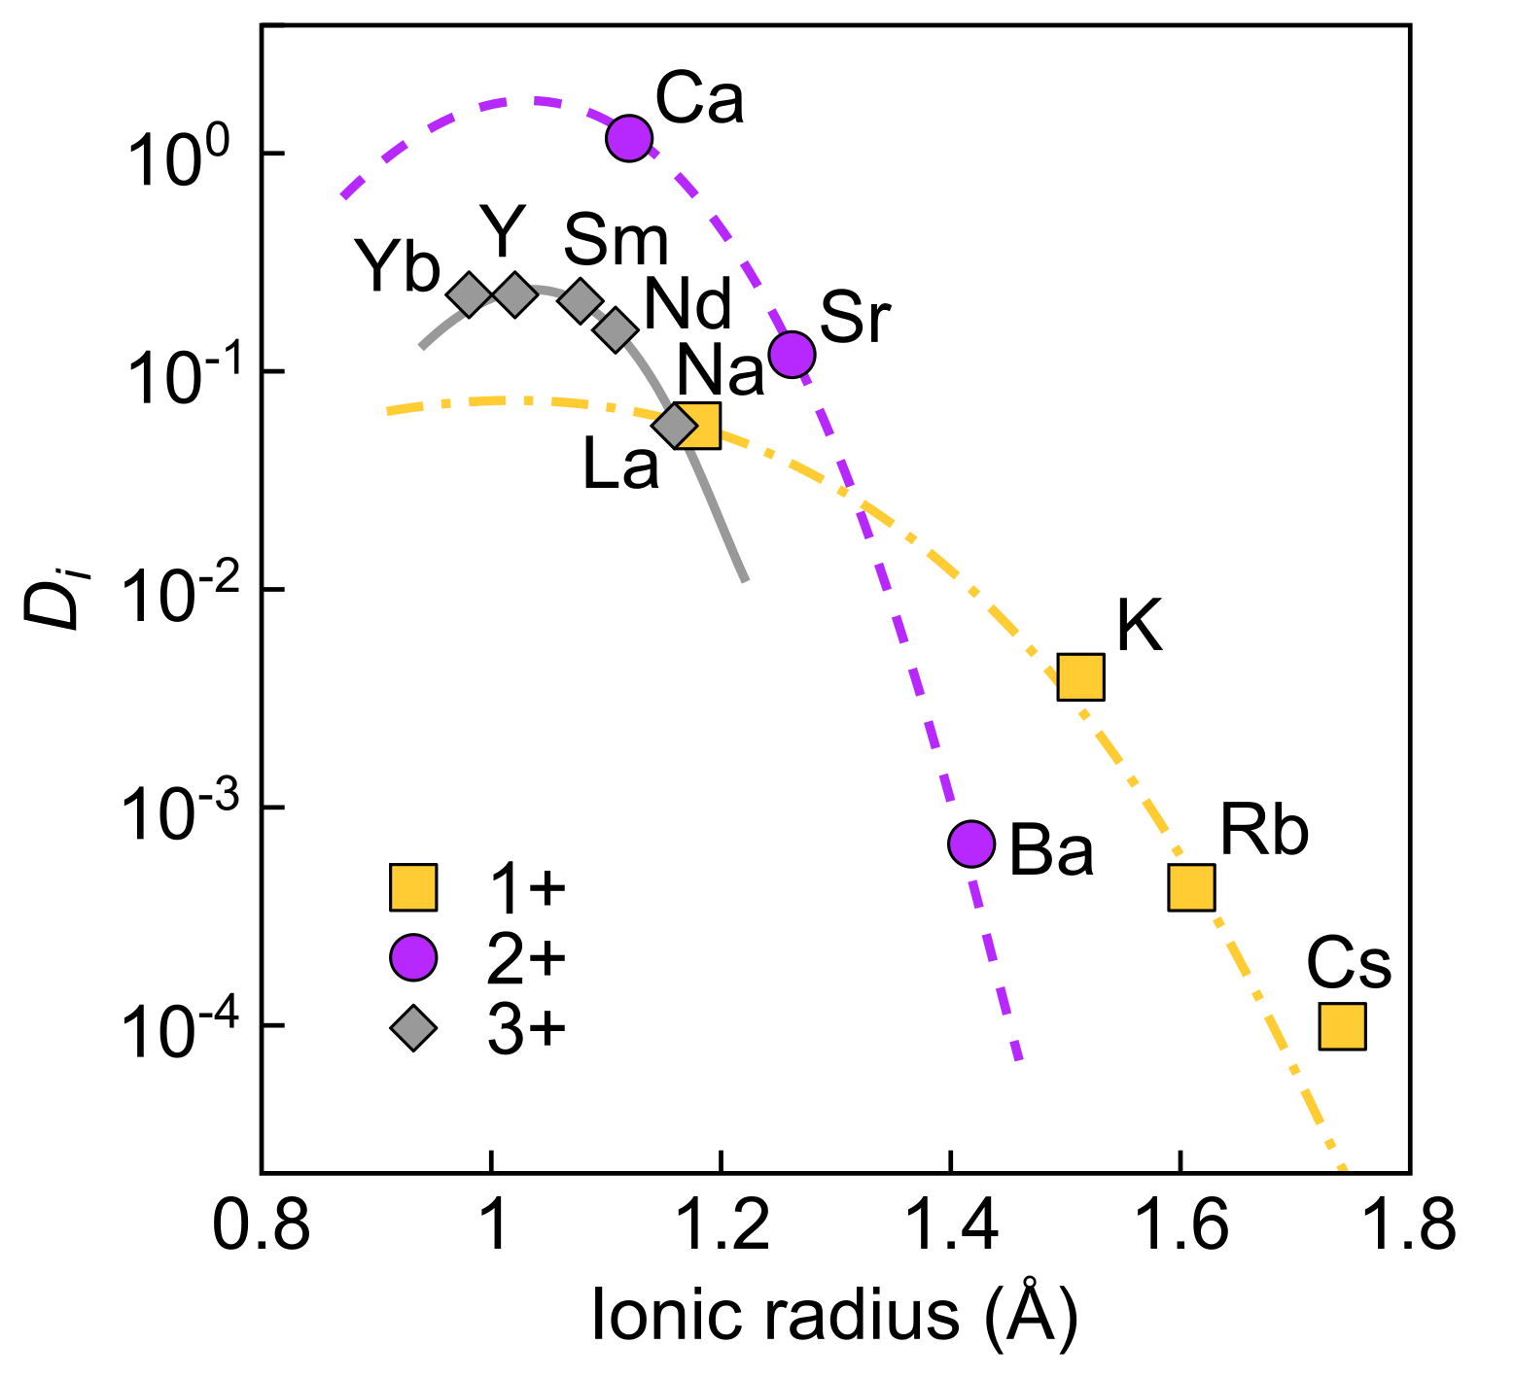
Factors affecting trace element partitioning
Ionic radius
  Avoid inducing lattice strain by introducing ions of different sizes
Charge
  Avoid introducing highly charged ions
  Avoid introducing charge imbalance
General rules of partitioning
  Large cations are typically incompatible
  Small divalent cations are often more compatible than small univalent cations
  Ionic radius more important than charge
pyroxene–liquid
Ca(Mg,Fe)Si₂O₆
Blundy & Wood (2003)

Slide 14
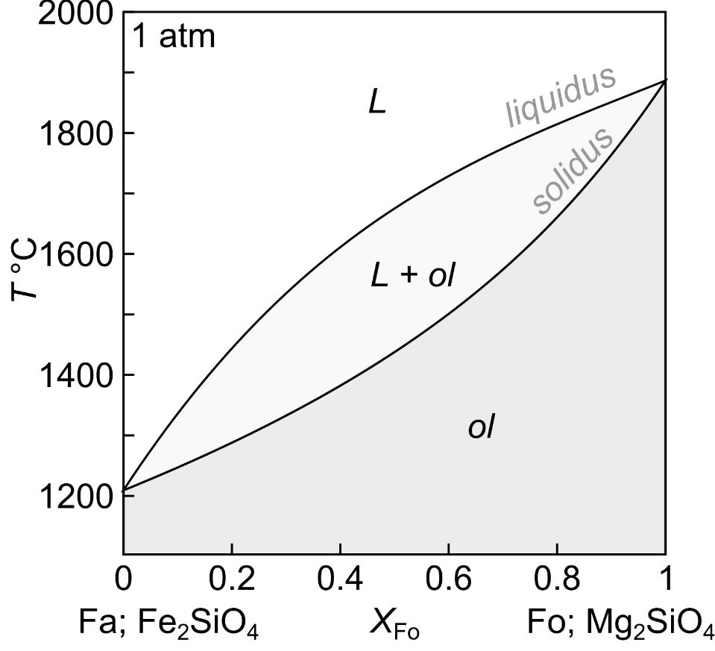
Goldschmidt’s Rules for element substitution
Ions of one element can extensively substitute for those of another if their radii differ by less than 15%
If two ions have similar radii and the same charge, the smaller ion is preferentially incorporated into the solid
K⁺ 1.33 Å
Rb⁺ 1.47 Å
Mg²⁺ 0.66 Å
Ni²⁺ 0.69 Å
If two ions have similar radii but different charges, the ion with the higher charge is preferentially incorporated into the solid
Mg²⁺ 0.66 Å
Fe²⁺ 0.74 Å
Liquid: K⁺ 1.33 Å, Y³⁺ 0.90 Å
Solid: Ba²⁺ 1.47 Å, U⁴⁺ 0.94 Å

Slide 15
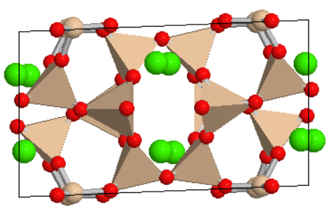
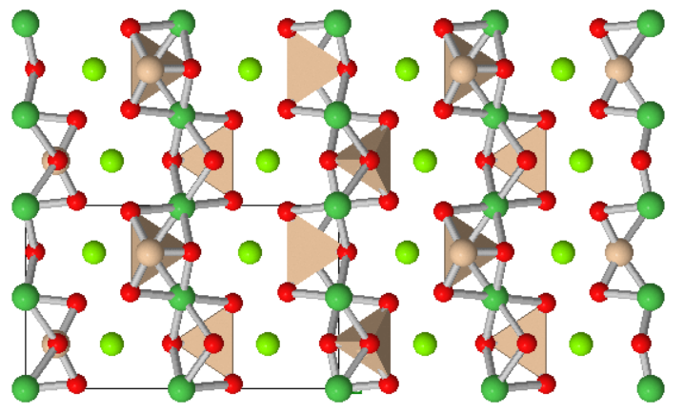
Goldschmidt’s Rules applied to igneous minerals
Anorthite (Ca-rich plagioclase): CaAl₂Si₂O₈
  Eu²⁺ and Sr²⁺ substitute for Ca²⁺ in anorthite
Olivine: (Mg,Fe)₂SiO₄
  Ni²⁺ and Co²⁺ substitute for Mg²⁺ and Fe²⁺
Na⁺ 1.40 Å
Ca²⁺ 1.26 Å
Sr²⁺ 1.33 Å
Eu²⁺ 1.33 Å
Ba²⁺ 1.55 Å
Cations
SiO₄ (+AlO₄)
tetrahedra
Mg²⁺ 0.66 Å
Fe²⁺ 0.74 Å
Ni²⁺ 0.69 Å
Co²⁺ 0.75 Å
Ca²⁺ 1.26 Å
Cations
SiO₄ tetrahedra

Slide 16
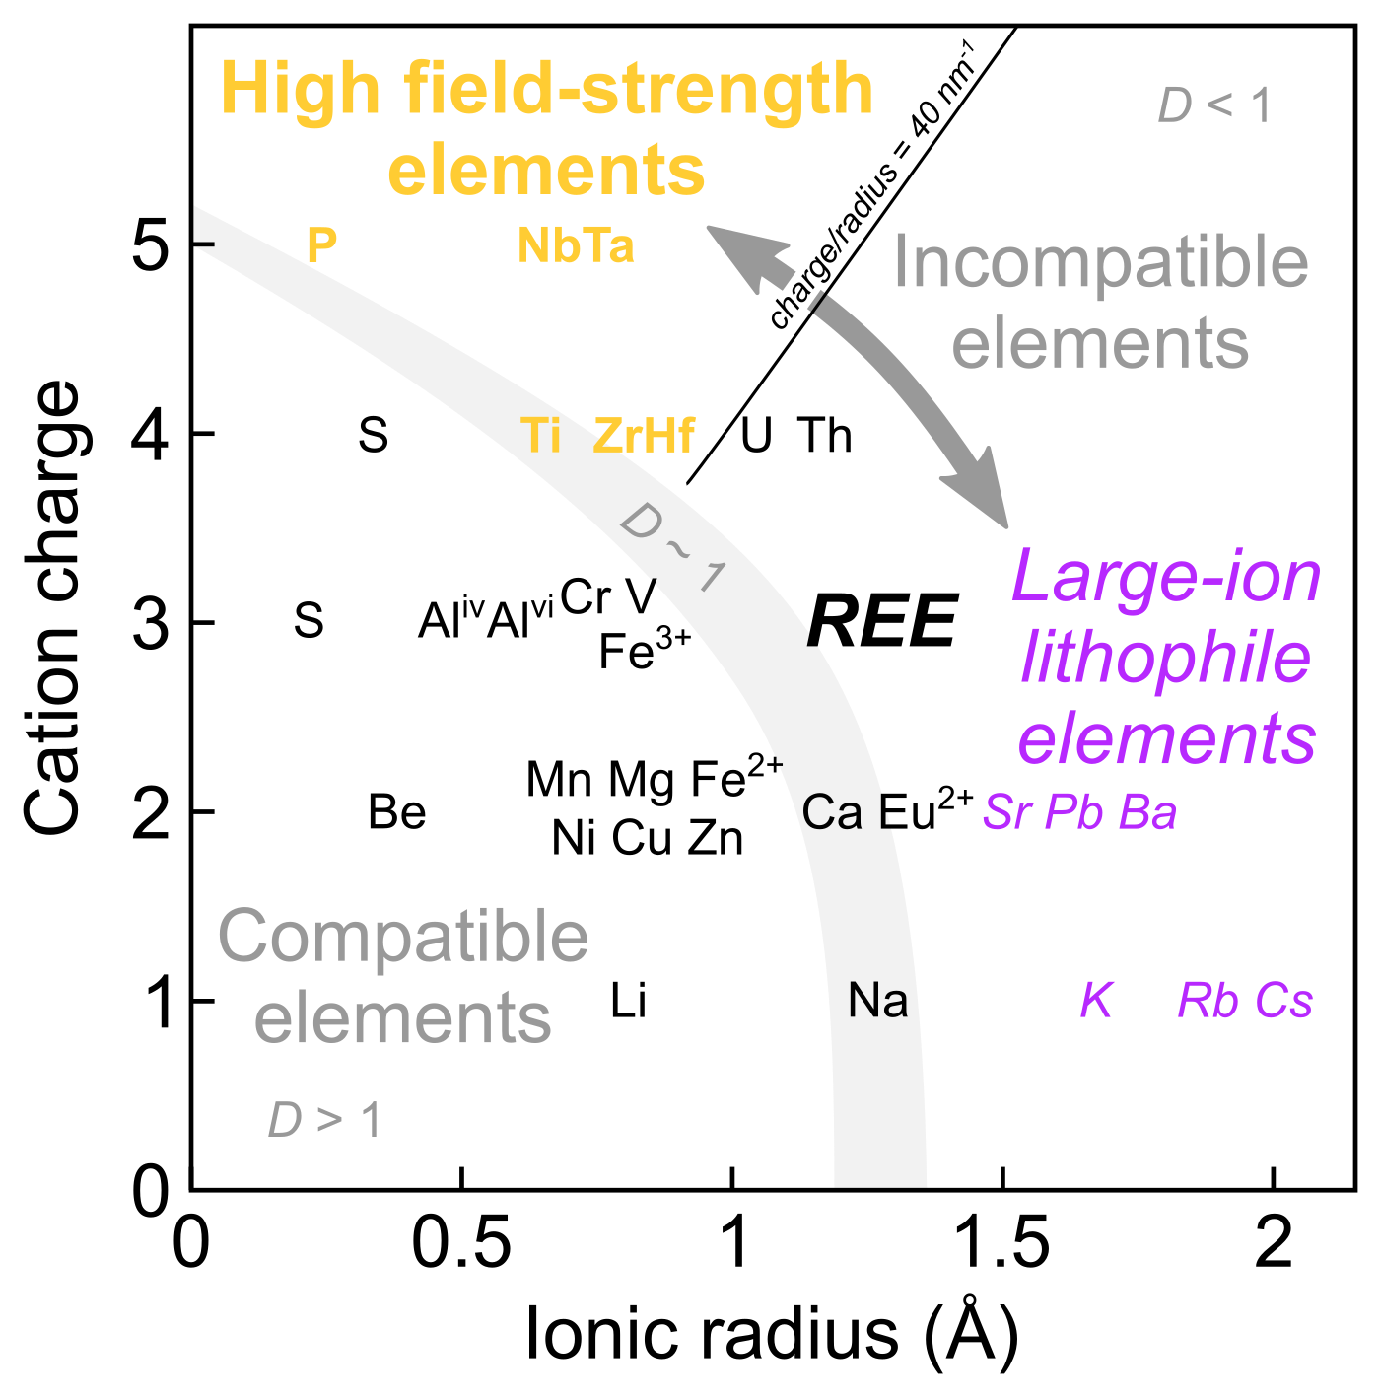
Types of incompatible trace element
Typical solid–liquid partitioning
Three key groups for igneous petrology
High field-strength elements (HFSE)
  Too highly charged to fit into crystal lattices
  Largely immobile in aqueous fluids
Large-ion lithophile elements (LILE)
  Too large to fit into crystal lattices
  Highly mobile in aqueous fluids
Rare earth elements (REE)
  La to Lu; very similar chemical properties
  Related behaviour during key geological processes like melting and crystallisation

Slide 17
The geochemist’s periodic table: element partitioning and
chemical differentiation
EART26201 | Principles of Geochemistry | Lecture 1
Part 4 | Using trace elements to model igneous processes

Slide 18
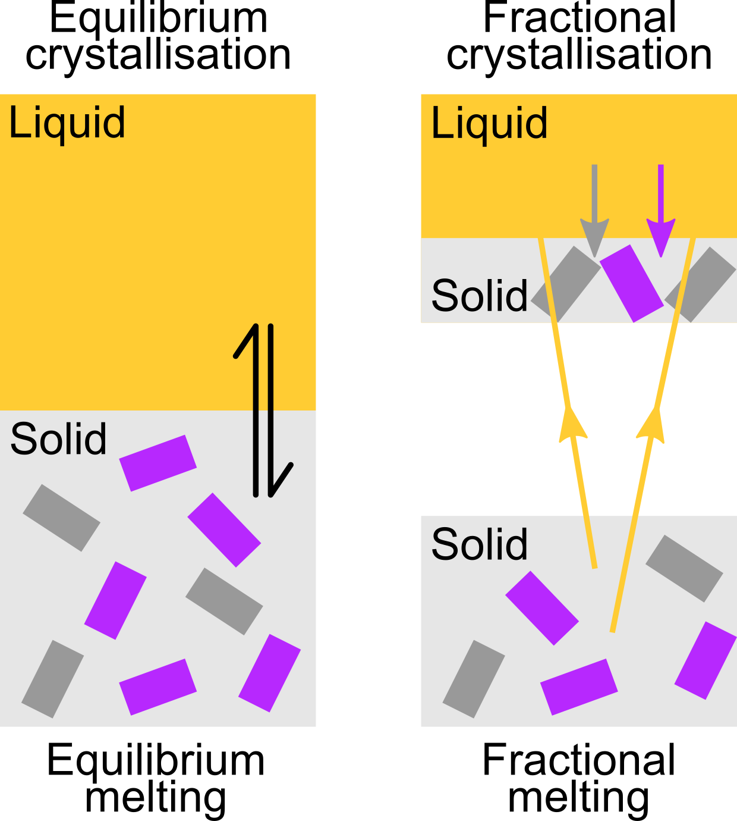
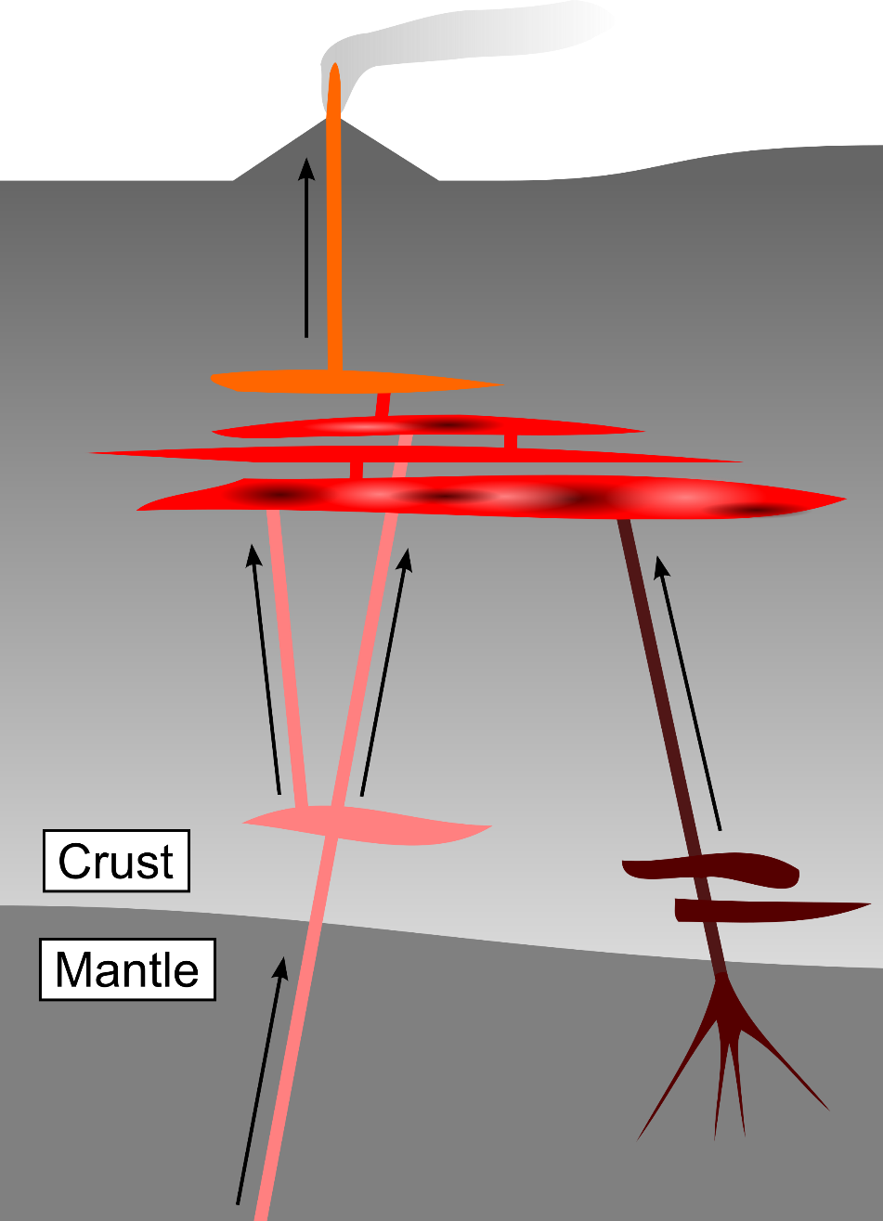
Magmatic processes: melting and crystallisation
Trace elements record geochemical processes
Trace elements can be used to:
  estimate extents of mantle and crustal melting
  estimate extents of magma crystallisation
  determine how different magmas (i.e. solidified igneous rocks) are related to each other
  understand and predict ore deposit formation
There are four scenarios to consider:
  Equilibrium melting
  Equilibrium crystallisation
  Fractional melting
  Fractional crystallisation

Slide 19
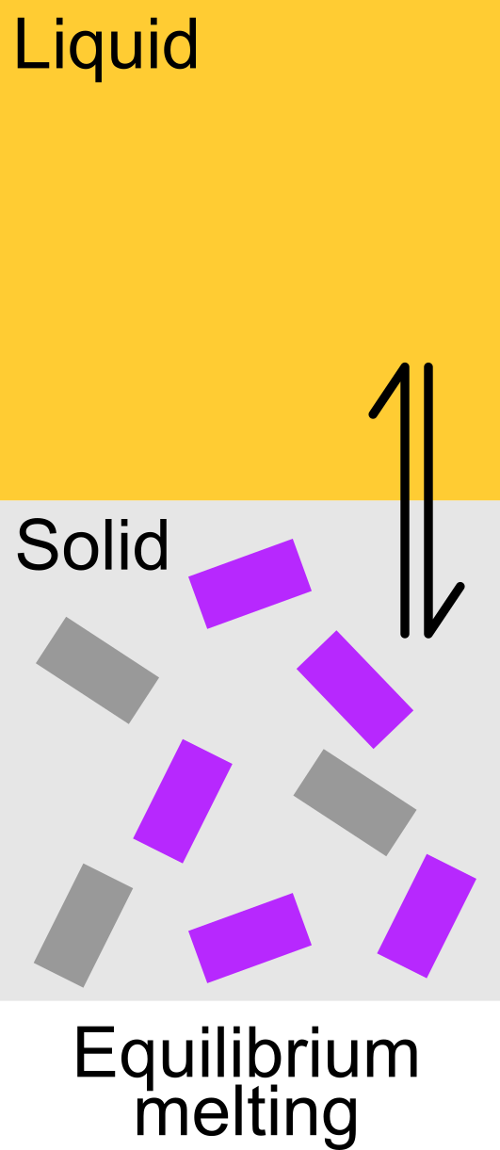
Equilibrium melting
The liquid remains in equilibrium with the solid residue
Concentrations of element $i$ in the liquid and solid are related by the bulk partition coefficient ${\overline{D}}_{i}$ as follows:
$${\overline{D}}_{i}=\frac{C_{solid}}{C_{liquid}}$$
The proportion of liquid is denoted $F$, so in a closed system:
$$C_{solid}^{0}={C_{liquid}F+C}_{solid}\left(1−F\right)$$
Combining these equations relates $C$ and $F$ in an equation that can be rearranged to solve geological problems:
$$C_{solid}^{0}=C_{liquid}\left({\overline{D}}_{i}\left(1−F\right)+F\right)$$
Initial $C$in solid

Slide 20
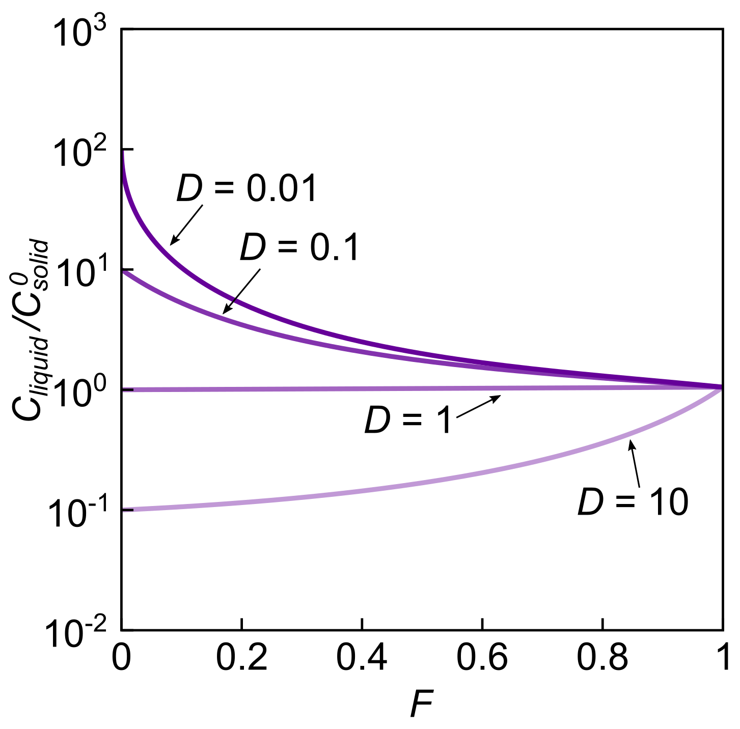
Equilibrium melting
Equilibrium melting:
$$\frac{C_{liquid}}{C_{solid}^{0}}=\frac{1}{\left({\overline{D}}_{i}+F\left(1−{\overline{D}}_{i}\right)\right)}$$
  Liquid in equilibrium with solid residue
Incompatible elements are highly concentrated in the melt at low $F$, and are diluted as $F$ increases
Compatible elements have very low concentrations in melts, especially at low $F$
First
liquid
Final
liquid
Final
liquid
Initial
solid
First
liquid
Notes:
SWAP THE COLOURS

Slide 21
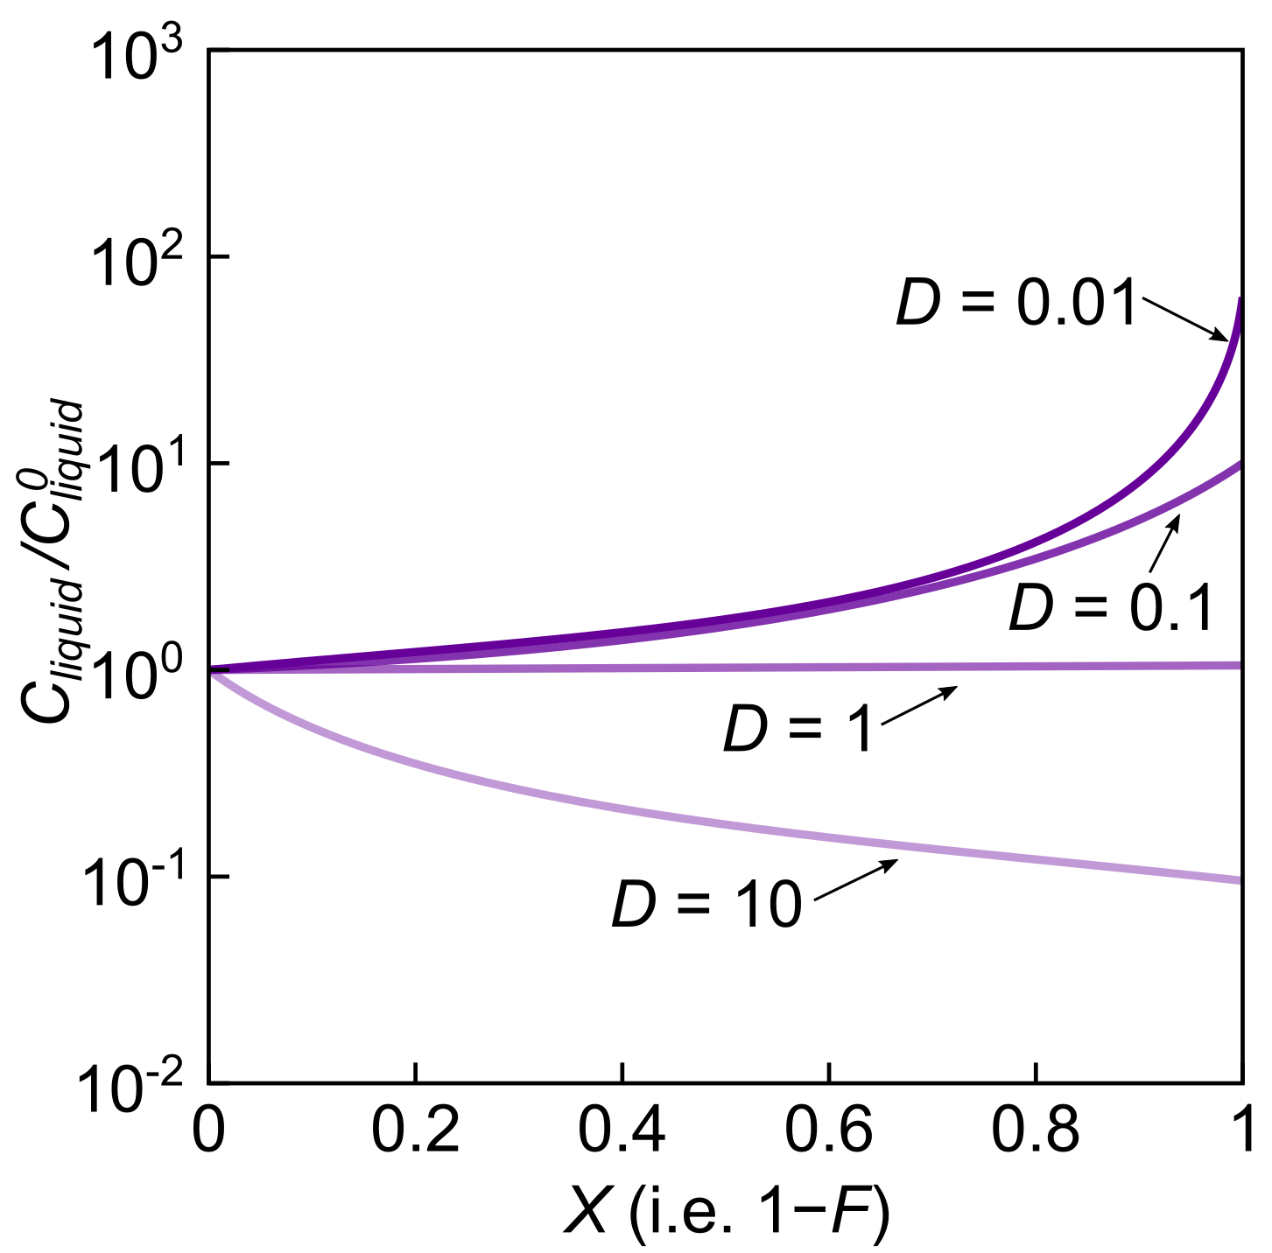
Equilibrium crystallisation
Equilibrium crystallisation:
$$\frac{C_{liquid}}{C_{liquid}^{0}}=\frac{1}{\left({\overline{D}}_{i}+(1−F)\left(1−{\overline{D}}_{i}\right)\right)}$$
  Solid in equilibrium with residual liquid
Initial $C$ in liquid is denoted $C_{liquid}^{0}$
The proportion of solid is often expressed as $X$, where $X=1−F$
Exact opposite of equilibrium melting
Final
liquid
Initial
liquid
Final
solid
Final
liquid

Slide 22
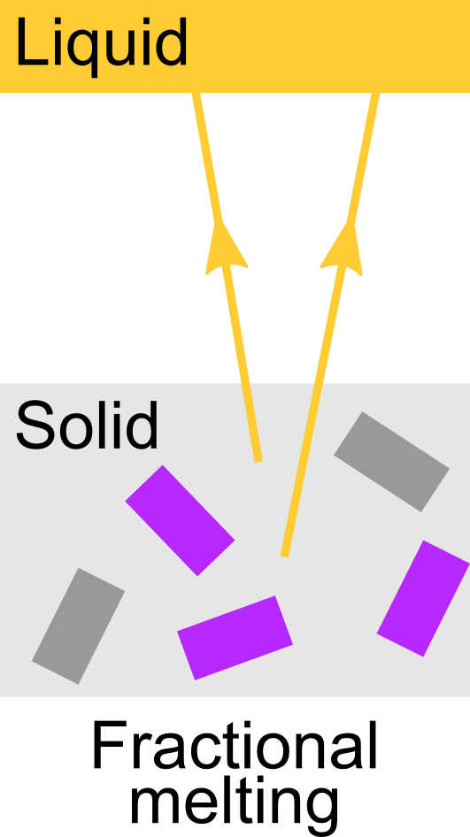
Trace element behaviour: fractional melting
The liquid leaves the system as soon as it forms
Incremental liquid compositions are typically reported
The composition of the system is the composition of the solid
Incompatible elements are depleted in the solid residue and thus the liquids that are subsequently derived from it
Relationships between $C$ and $F$ are described by:
$$\frac{C_{liquid}}{C_{solid}^{0}}=\frac{1}{{\overline{D}}_{i}}{\left(1−F\right)}^{\left(\frac{1}{{\overline{D}}_{i}}\right)−1}$$
Incremental melts can accumulate (e.g. in magma reservoir)
Accumulated fractional melts are similar to equilibrium melts

Slide 23
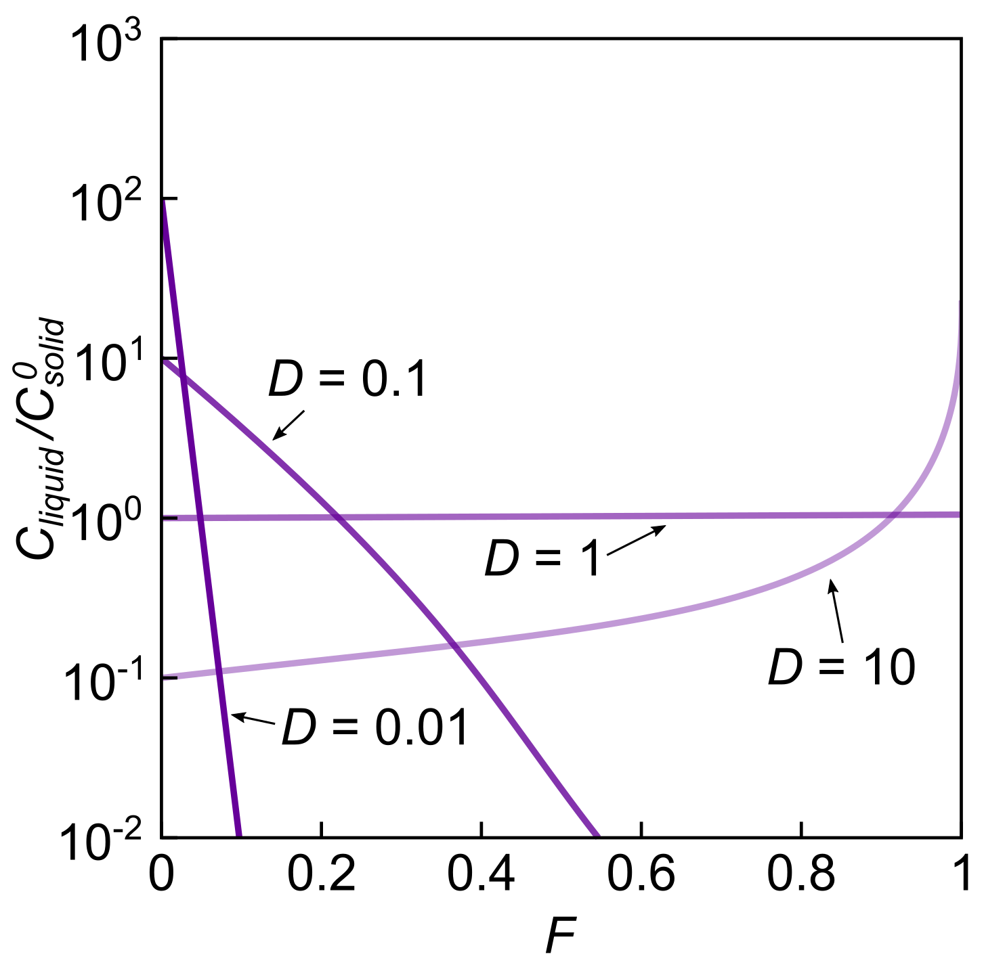
Trace element behaviour: fractional melting
Fractional melting:
$$\frac{C_{liquid}}{C_{solid}^{0}}=\frac{1}{{\overline{D}}_{i}}{\left(1−F\right)}^{\left(\frac{1}{{\overline{D}}_{i}}\right)−1}$$
  Liquids leave as soon as they form
Incompatible elements are rapidly depleted in the solid residue, so liquids are also rapidly depleted
Compatible elements are initially retained in the solid, so the last liquids are relatively enriched
Maximum enrichment: $\frac{1}{D}$

Slide 24
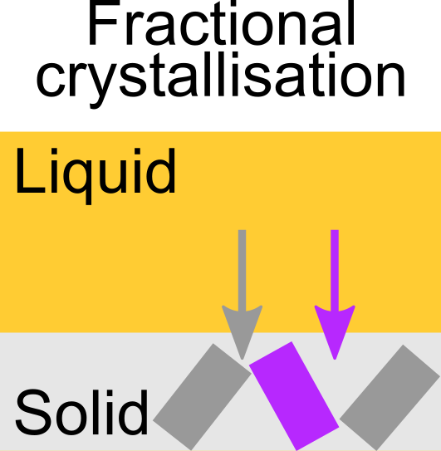
Trace element behaviour: fractional crystallisation
The solid leaves the system as soon as it forms
The composition of the system is the composition of the liquid
Incompatible elements are progressively concentrated
Relationships between $C$ and $F$ are described by:
$\frac{C_{liquid}}{C_{liquid}^{0}}=F^{\left({\overline{D}}_{i}−1\right)}$ Rayleigh Distillation
The dominant way in which magmas crystallise on Earth
The insides of solids are effectively isolated from their surroundings because of kinetics (see Lecture 5)
Can produce extreme element enrichments (i.e. ore deposits)

Slide 25
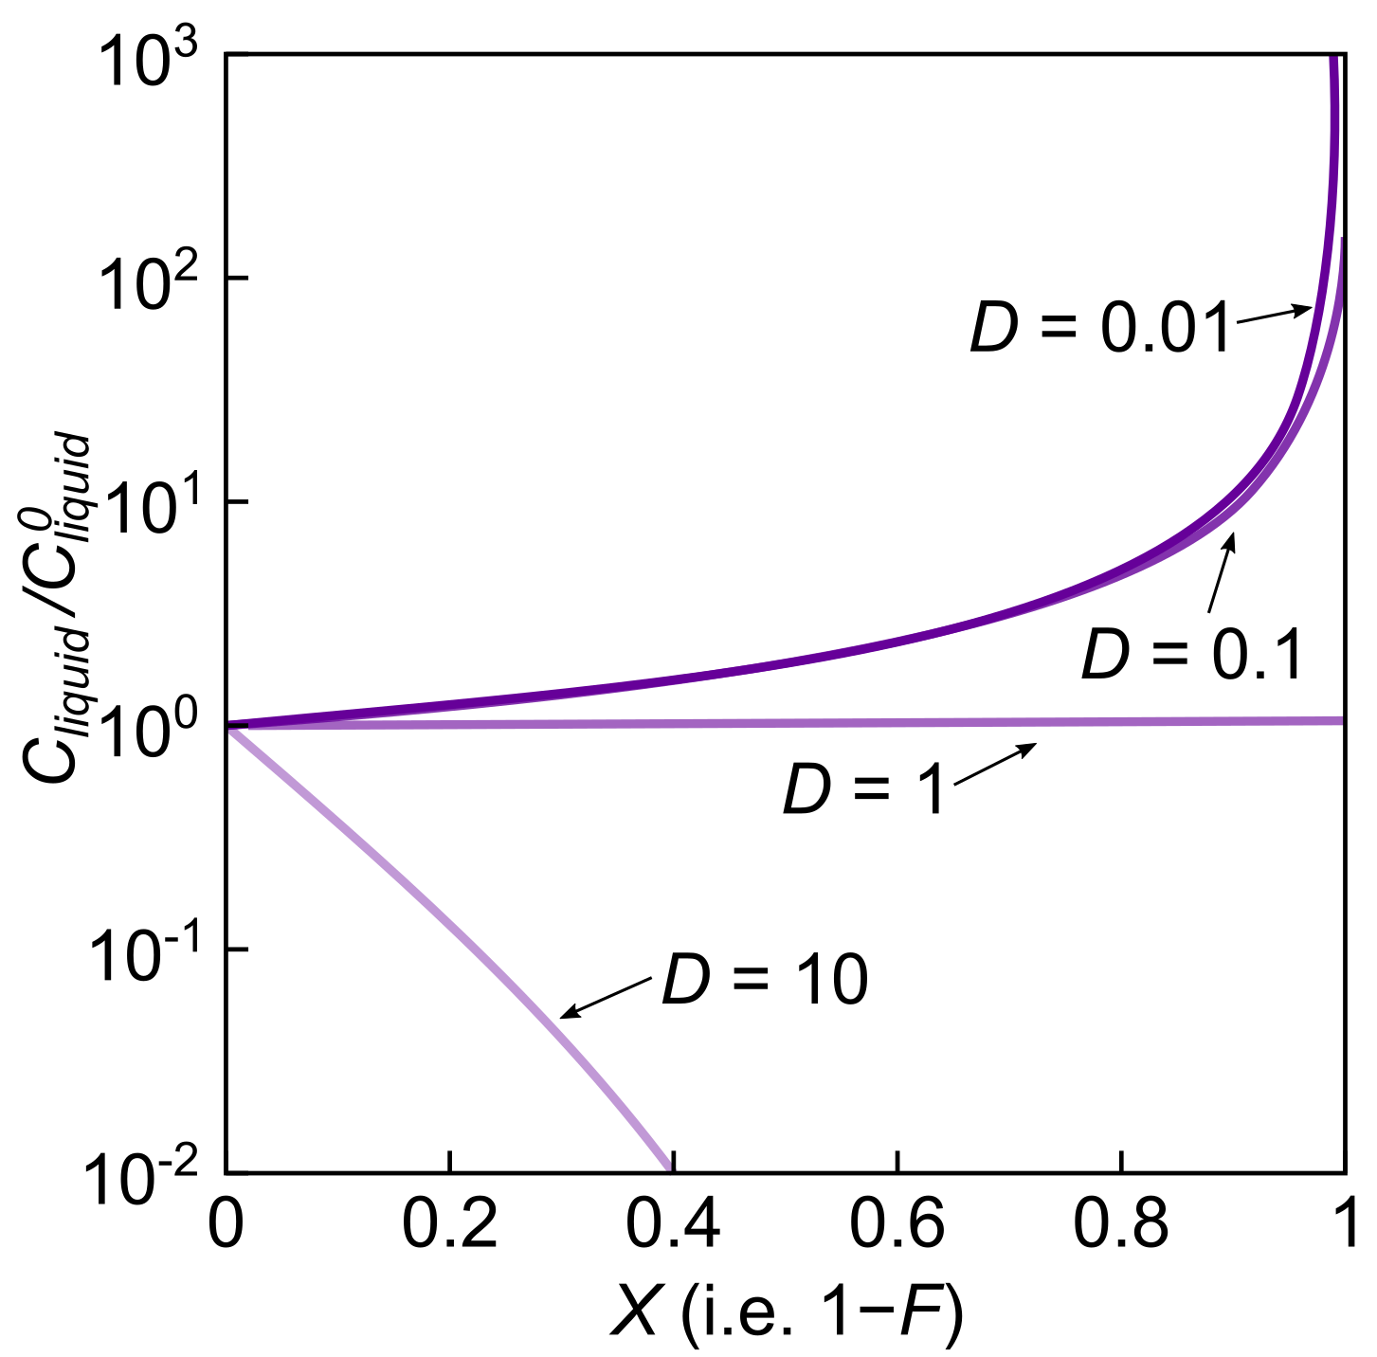
Trace element behaviour: fractional crystallisation
Fractional crystallisation:
$$\frac{C_{liquid}}{C_{liquid}^{0}}=F^{\left({\overline{D}}_{i}−1\right)}$$
  Solids leave as soon as they form
Incompatible elements remain in the system (i.e. not in solids), so liquids become highly enriched
Compatible elements are rapidly removed from the system, leaving highly depleted residual liquids
Not the opposite of fractional melting

Slide 26
The geochemist’s periodic table: element partitioning and
chemical differentiation
EART26201 | Principles of Geochemistry | Lecture 1
Part 5 | Chemical differentiation of the Earth

Slide 27
Chemical differentiation reflects element partitioning
Elements partition into different reservoirs
Geochemical reservoirs are domains with distinct and internally coherent chemical characteristics:
  Siderophile – core
  Chalcophile – core
  Lithophile – mantle & crust
  Atmophile – atmosphere

Slide 28
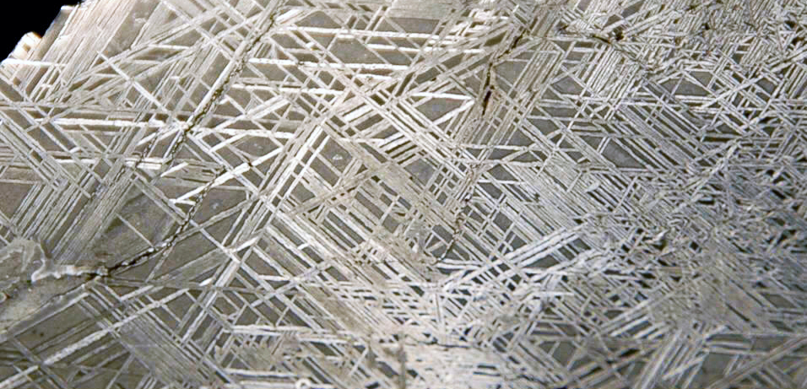
Composition of the core
16% of Earth’s volume; 31% of Earth’s mass
The inner core is solid; the outer core is liquid (S waves; geodynamo)
Fe and Ni dominate (~90 and ~5 wt.%); Fe/Ni of the core is similar to chondrites
Density is 5–15% lower than pure alloy; light elements must be present (H, C, S, O or Si)
Siderophile elements are depleted in the mantle but enriched in the core
Chalcophile elements are enriched in the core because sulfide is siderophile
Iron meteorite (credit: Odessa Meteor Crater Museum)
Boujibar et al. (2015)
Photo: James St. John

Slide 29
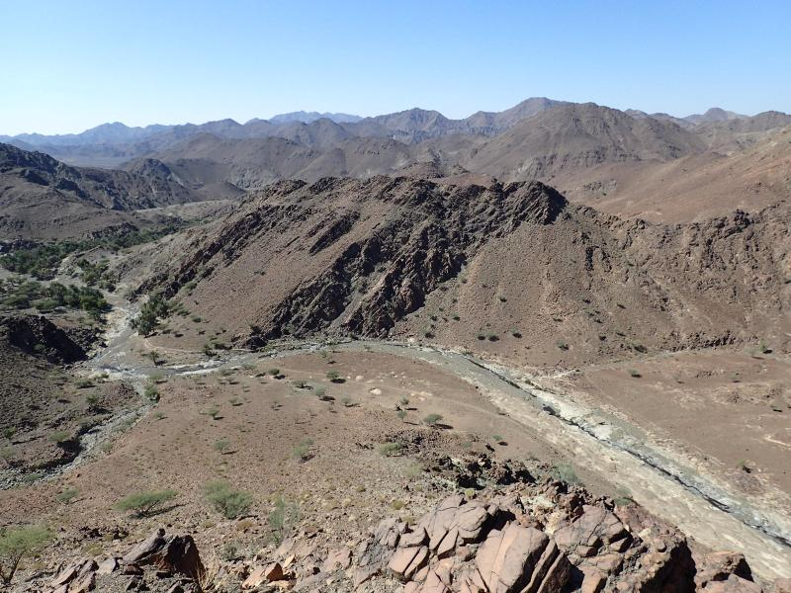
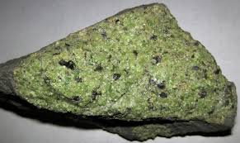
Composition of the mantle
83% of Earth’s volume; 68.3% of Earth’s mass
Bulk Silicate Earth (BSE) ≈ CI chondrite − Core
BSE sometimes referred to as Primitive Mantle
O, Si, Mg and Fe dominate alongside Ca and Al
Mantle composition determined from meteorites, xenoliths and ophiolites
credit: Oman Drilling Program

Slide 30
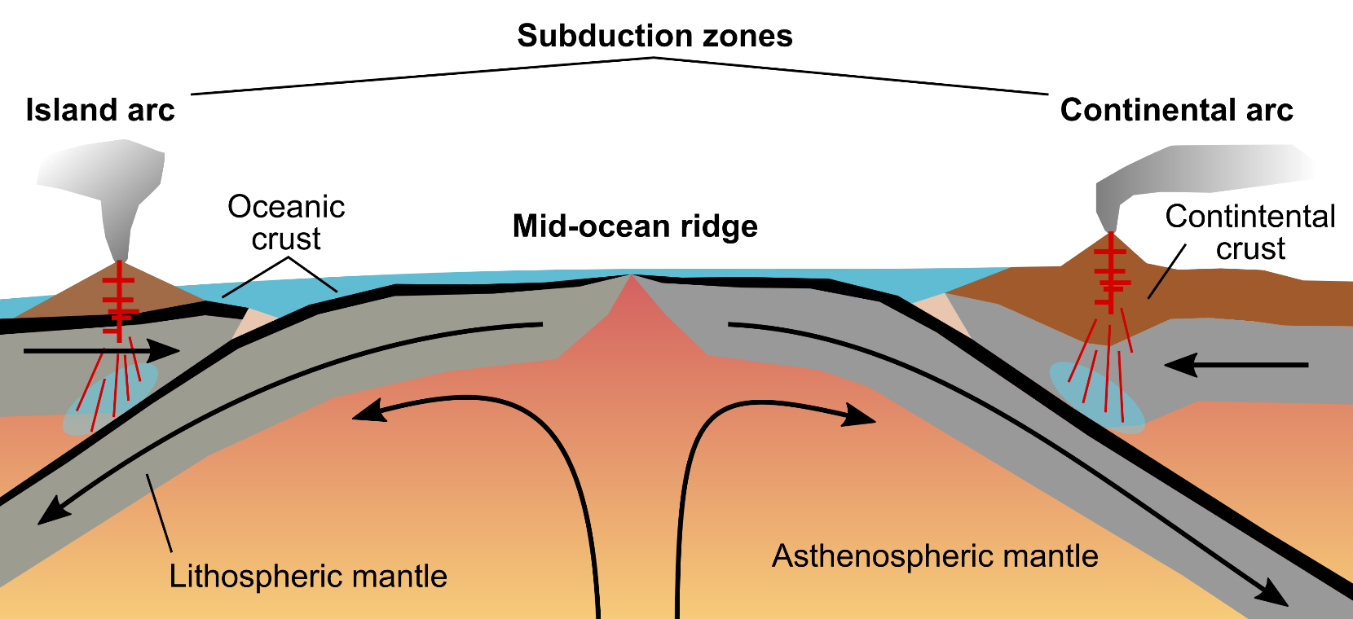
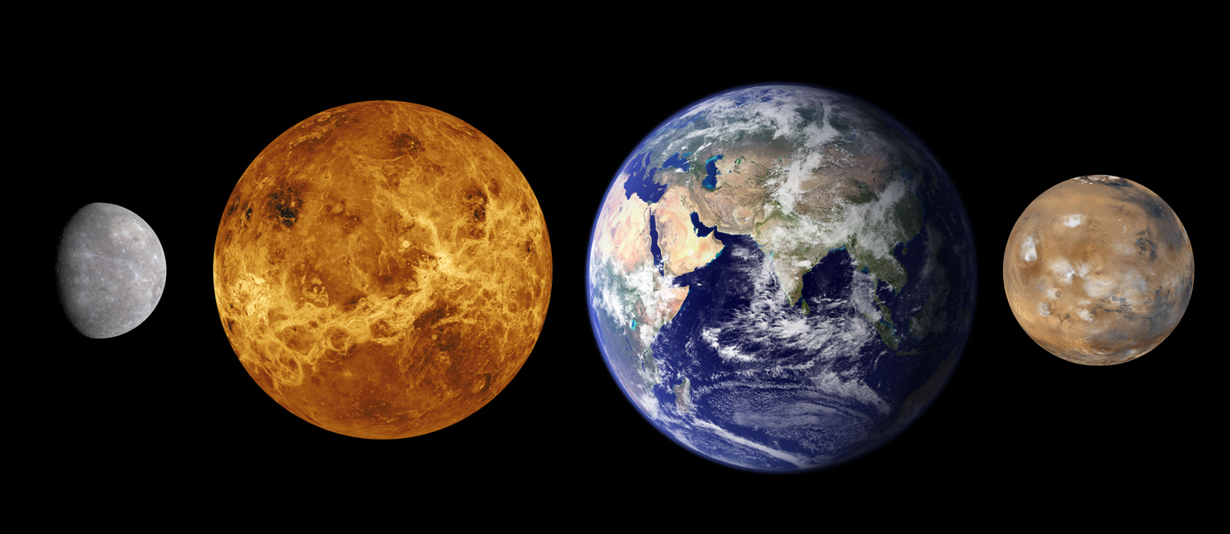
Composition of the crust
Insignificant contribution to Earth’s volume; 0.7% of Earth’s mass
99 wt.% of the crust is composed of O, Si, Al, Fe, Mg, Na and K
Uniquely divided between oceanic crust and continental crust
Oceanic crust: rich in Ca, Mg and Fe; covers 70% of Earth’s surface
Continental crust: rich in Si, Na, K and incompatible elements; covers 30%
Unique in the solar system
credit: NASA

Slide 31
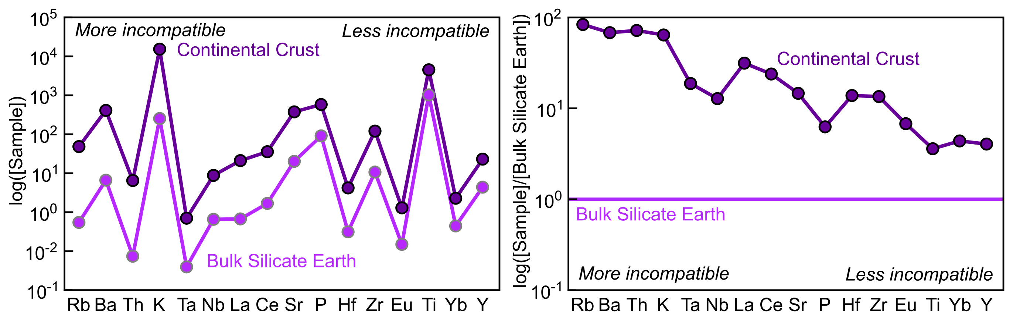
Tracking crustal processes with trace elements
Multi-element plots show trace elements ordered by their compatibility
Absolute concentrations are hard to interpret (Oddo-Harkins rule)
Element concentrations are normalised to key reservoirs (e.g. CI, BSE)

Slide 32
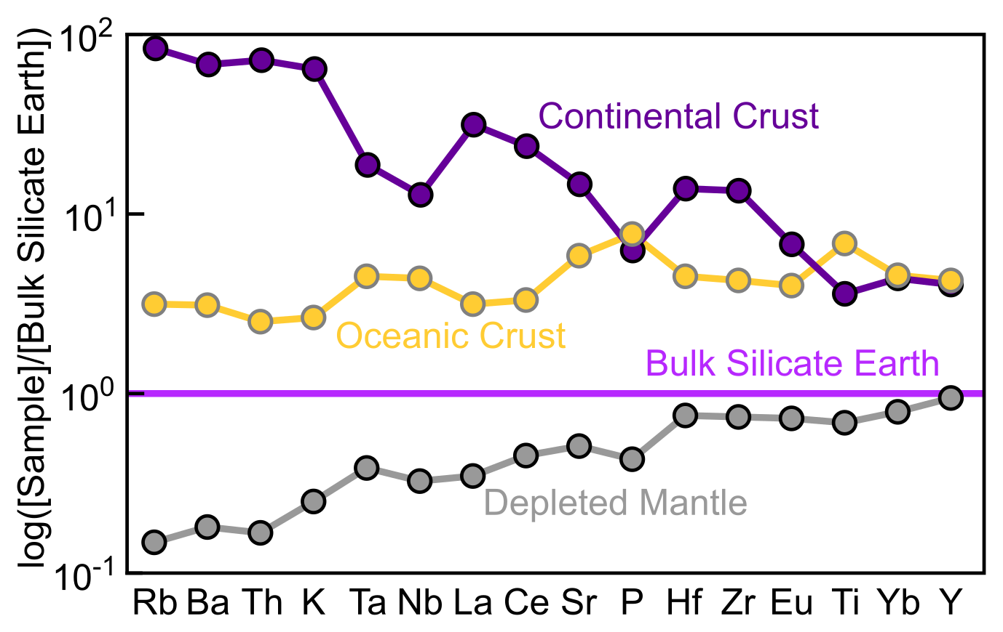

Continental crust formation
Mean composition is andesitic; grades from basaltic at the base to granitic at the top
1 wt.% of BSE, but contains up to 50% of BSE’s incompatible elements, including radioactive elements like U, Th and K
Depleted in HFSE, suggesting formation in subduction zones: HFSE are immobile in aqueous fluids released from subducting slabs that drive flux melting (unlike LILE)
Removing the continental crust from BSE probably created the Depleted Mantle

Slide 33
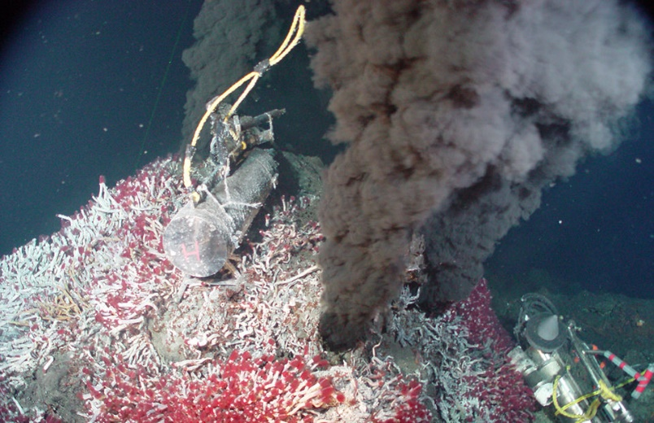
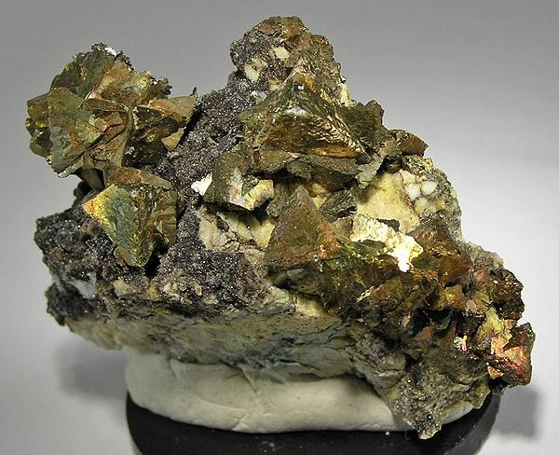
Oceanic crust formation
Mean composition is basaltic, but stratified from ultramafic (base) to basaltic (top)
Slightly enriched in incompatible elements with respect to BSE
Relatively depleted in highly incompatible elements; oceanic crust is mostly created by melting the Depleted Mantle
Relatively enriched in compatible elements like Ni and Cr
Contains sulfide deposits rich in chalcophile and technologically important elements
like Cu and the Platinum Group Metals
credit: NOAA

